Slide 1
The need for reliable biomarkers for monitoring potential treatments in Alzheimer's disease
Goran Šimić
Department of Neuroscience
Croatian Institute for Brain Research
University of Zagreb Medical School
Croatian Science Foundation
CM1103 Action conference
“Interdisciplinary Chemical Approaches for Neuropathology”
Chairs: Rona Ramsay and Giuseppe Di Giovanni
Valletta, MALTA
23rd October 2013

Slide 2
Biomarker is
any biological characteristics that can be objectively measured and evaluated as an indicator of normal biological processes, pathogenic processes, or pharmacological responses to a therapeutic intervention.
Naylor S. Biomarkers: current perspectives and future prospects. Expert Rev. Mol. Diagn. 2003, 3, 525–529, 2003

Slide 3
2 major types of biomarkers
Biomarkers of exposure – used in risk prediction
Biomarkers of disease – have the potential to:
- identify disease early (if good they are used in screening)
- aid making proper diagnosis (if good provide a method for homogeneous
classification of a given disease and extend knowledge concerning the
underlying disease pathogenesis)
- follow-up disease progression

Slide 4
Major concerns:
Variability (applies regardless of whether the biomarker represents an exposure or effect modifier, a surrogate of the disease, or an indication of susceptibility):
- interindividual (e.g. ability to metabolize or different types of exposure)
- intraindividual (usually related to laboratory errors or other conditions)
- group (this is often the desired outcome)
Validity (reliability, ascertainment bias, and interpretation of biomarker data should be reviewed just as carefully as any other variable):
- content (the degree to which a biomarker reflects the biological phenomenon studied)
- construct (pertains to other relevant characteristics of the disease or trait)
- criterion (specificity, sensitivity and predictive power - PPV/NPV)
Schulte PA, Perera FP. Validation. In: Molecular epidemiology: principles and practices (Schulte PA, Perera FP, eds), pp 79–107. San Diego: Academic Press, 1993.

Slide 5
Additional issues
Measurement errors (due to differences in collection equipment, transportation, personnel training, etc.) SOLUTION: QUALITY CONTROL
Bias (occurs mostly when availability of the biomarker is differentially related to the disease or when the specimen procedures differ) SOLUTION: MAINTAINING A HIGH RESPONSE RATE FROM ALL CASES
Confounding (identifying factors that may alter the measurement)
Cost (feasibility at population level, acceptable biomarker profile – „false-positives” create extra work, „false-negatives” increase the cost)
Acceptability (CSF is more difficult to obtain and also associated with a higher risk-benefit ratio)
Mayeux R. Biomarkers: Potential Uses and Limitations. NeuroRx, 2004, 1, 182-188

Slide 6
Main measure to evaluate criterion validity of a biomarker:
1 (Patological) specificity (correct identification of negative individuals)
2 (Early) diagnostic sensitivity (correct identification of positive cases)
3 Correlation with disease progression

Slide 7
6 main biomarker approaches to the diagnosis and monitoring potential treatments of AD
behavioral assessment, including measurement of cognitive status using various neuropsychological scales (MMSE, ADAS-Cog, etc.)
changes in brain structure (mainly volume of the cerebral cortex, particularly entorhinal cortex and hippocampus)
alterations in brain’s functional (fMRI) and structural (DTI) connectivity, and metabolism (FDG-PET) most notably within the default mode network
measurement of β-amyloid load within the brain (PIB-PET), and of neurofibrillary tangles (FDDNP-PET)
CSF biomarker profiles (the three main CSF biomarkers of AD being β-amyloid, total tau, and phosphorylated forms of tau proteins)
(post-mortem confirmation of characteristic AD histopathology).

Slide 8
1. Behavioral assessment: AD – neuropsychol. profile
123
Percentage of patients
Modified according to: Weintraub S. et al., Cold Spring Harb. Perspect. Med. 2012;2:a006171

Slide 9
Frontotemporal dementia (BV/PNFA/SD)
Percentage of patients
Modified according to: Weintraub S. et al., Cold Spring Harb. Perspect. Med. 2012;2:a006171

Slide 10
Primary progressive aphasia
Percentage of patients
Modified according to: Weintraub S. et al., Cold Spring Harb. Perspect. Med. 2012;2:a006171

Slide 11
Why clinics (neuropsychological testing) lacks specificity and sensitivity?
The main reason is the fact that most NDD begin much earlier than clinical symptoms!
In case of AD it has been estimated that neurofibrillary changes start somewhere between 15-25 years before the onset of clinical symptoms!

Slide 12
PROGRESSIVE
DETERIORATION OF
EXECUTIVE F-ONS
PRIMARY
PROGRESSIVE
APHASIA
PROGRESSIVE
VISUO-
SPATIAL
DYSFUNCTION
PROGRESSIVE
AMNESIA
Clinical dementia profile
Resulting deficits reflect anatomical distribution of pathological changes
Neuroanatomical distribution of pathological changes
FRONTAL
LOBE
FRONTAL AND
TEMPORAL CORTEX
PARIETAL AND
OCCIPITAL CORTEX
HIPPOCAMPUS
AND ENTORHINAL
CORTEX
Predilection
probability
FRONTO-
TEMPORAL
DEMENTIA
Neuropatholicial diagnosis
FOCAL
ATROPHY
LEWY-BODY
DISEASE
ALZHEIMER’S
DISEASE

Slide 13
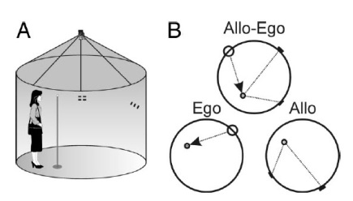
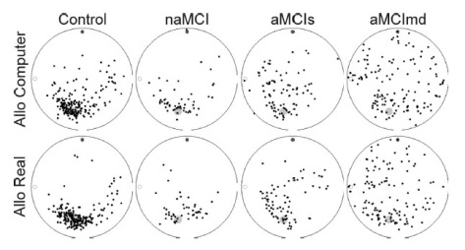
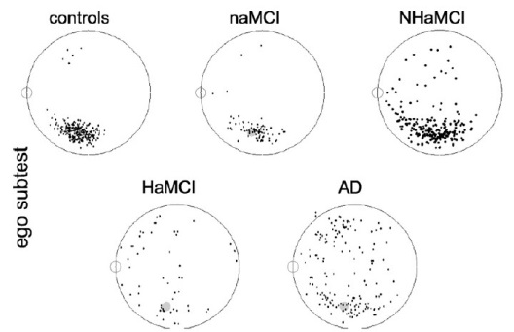
Hidden goal test – human analog of Morris water-maze task
Better sensitivity than neuropsychological assessment?
Hort et al., PNAS, 2007, 104, 4042-4047; Laczo et al., Behav. Brain Res. 2009; Neurodegen. Dis. 2010;

Slide 14
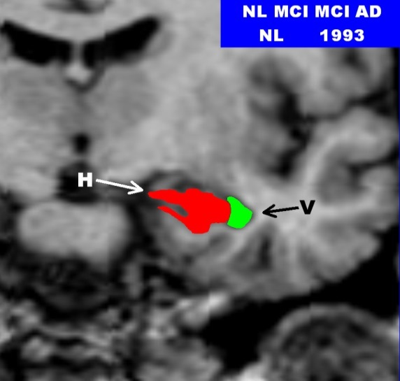
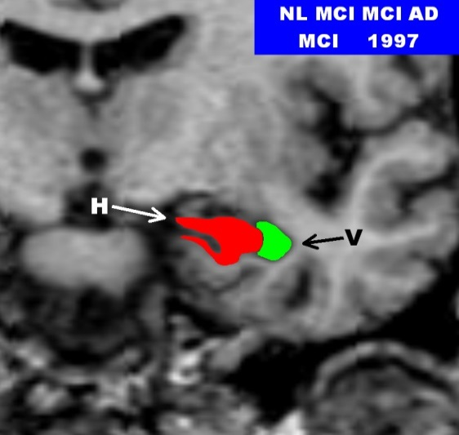
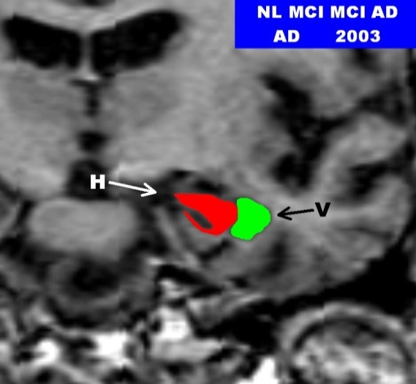
2 and 3c. Atrophy (MRI) and hypometabolism (FDG PET) of HF and EC
90% accurate prediction of MCI to AD conversion 4 years before disease onset (NYU, 2003)
84% accurate prediction of HC to MCI conversion 4 years before MCI onset (NYU, 2003)
76% accurate prediction of HC to MCI 7 years before MCI onset (Mosconi et al., Neurobiol. Aging, 2007)
123
HC
MCI
AD
1993
1997
2003
E
E
E

Slide 15
3a. Functional MRI (fMRI)
Non-invasively measure brain activity
Most popular method observes neuron activity indirectly by measuring vascular and hemodynamic signals:
- change in blod flow and oxygenation
(oxygenated vs. deoxygenated blood) in
active brain areas is measured using MRI
- the primary form of fMRI uses the BOLD
(blood oxygenation level dependent) contrast
first used by Seiji Ogawa in 1990 at AT&T Bell labs,
Murray Hill, NJ, USA
Ogawa S. et al., Brain magnetic resonance imaging with contrast dependent on blood oxygenation. PNAS, 1990, 87, 9868-9872

Slide 16
Task-related fMRI
An experimental task of interest is presented alternately with a control task and the BOLD signal during the experimental task is compared to the BOLD signal during the control task
The difference between baseline and task-related activation accounts for about 1–5% of the total BOLD signal
Thus, compared to ongoing ‘baseline’ brain activity, only a small percentage is needed to respond to an external stimulus
However, the functions of this vast amount of baseline activity remained unclear

Slide 17
Resting-state fMRI
Focuses on spontaneous, rather than task-induced, fluctuations in the blood oxygenation level-dependent (BOLD) signal
In the first resting-state fMRI study (Biswal, Magn. Reson. Med., 1995), the time course of a seed region-of-interest (ROI) in the left motor cortex was correlated with the time course of all other brain voxels
The resulting map demonstrated functional connectivity between the left and right motor cortex even in the absence of a task
fMRI has since been used to demonstrate that the brain is segregated into a wide array of 15 or more functional networks mediating a host of sensory, motor, cognitive, and affective functions (Smith et al., PNAS, 2009)

Slide 18
Resting-state fMRI (2)
Limitations: the seed ROI must be selected by the investigator; a preprocessing step of regressing the global signal can induce false negative correlations between brain regions (Murphy et al., NeuroImage, 2009)
To avoid these issues independent component analysis (ICA) decomposes (separates) the 4-dim. (brain volume over time) BOLD signal into a set of spatially distinct maps and their associated time courses (Beckmann et al., Philos. Trans. R Soc. Lond. B, 2005).
A general limitation to resting-state fMRI is that it is very difficult to separate physiological noise, induced by the cardiac pulse and respiration, from the BOLD signal (Birn et al., Hum. Brain Mapp., 2008)
ICA separates linearly mixed sources:
Task related
Heart-beat related
Breathing related
Vasomotor oscillation
Motion related
„white noise”

Slide 19
ICA principle
A
2 independent sources
B
Linear mix: A-2B
Linear mix: 1.73*A+3.41*B
ICA algorithm

Slide 20
ICA applied to resting-state data identifies 8 main cortical networks
Primary
vision
Higher order
visual
processing
Hearing
Touch and
movement
DMN
(memory)
Salience
processing
Executive
control
Executive
control
Beckman et al., 2005, Philos. Trans. R Soc. Lond. B, 2005, 360, 1001–1013
Greicius M, Curr. Opin. Neurol., 2008, 21, 424-430

Slide 21
DMN activity at individual and group level
Individual best fit to standard DMN template among 26 components
Computed from 13 mean images
Greicius and Menon, J. Cogn. Neurosci., 2004, 16, 1484-1492

Slide 22
fMRI - default mode network (DMN)
The DMN includes:
mPFC,
PCC,
precuneus,
ACC,
parietal cortex and in a minority of studies also the hippocampus
Hafkemeijer et al., Biochim. Biophys. Acta, 2012, 1822, 431-441
It seems that DMN connectivity reflects the level of consciousness (Greicius et al., Hum. Brain Mapp., 2008; Vanhaudenhuyse et al., Brain, 2010), generates spontaneous thoughts, and preferentially activates when individuals engage in internal tasks such as daydreaming, envisioning the future, and retrieving memories, while it is negatively correlated with brain systems that focus on external visual signals
In a subject resting quietly for 8 min during an fMRI scan, BOLD signal will fluctuate up and down at a very low frequency (<0.1 Hz) - these low-frequency BOLD signal fluctuations are strongly correlated in time across regions that are known to be functionally connected
DMN undergoes developmental changes and coherent neuronal oscillations at a rate lower than 0.1 Hz become more consistent in children aged 9-12 years and in older subjects

Slide 23
DMN FC correlates with the level of consciousness
Vanhaudenhuyse et al., Brain, 2010, 133, 161-171

Slide 24
DMN activity is weaker in children (in mPFC)
Supekar et al., NeuroImage, 2010, 52, 290-301

Slide 25
3b. Diffusion tensor imaging (DTI)
DTI measures the diffusion of water molecules in the brain (Le Bihan 2003; Moseley et al., 1990)
In an unrestricted environment, water molecules diffuse freely in any direction. In the brain however, diffusivity is restricted by the brain’s architecture such that water diffuses more readily along axons rather than across them; measuring the direction of diffusivity can be used, therefore, to infer the orientation of white matter tracts in the brain

Slide 26
DTI (2)
Several measures are used to quantify WM integrity using DTI, the most common being fractional anisotropy (FA), mean diffusivity (MD), fiber count (FC) and probabilistic tractography (PT).
FA is a scalar measure of the degree of anisotropy (direction selectivity; higher FA values are also generally interpreted as reflecting healthier WM) and MD is a scalar measure of the total diffusivity (these two measures are calculated within a voxel)
FC and PT result from tracking the principle diffusion direction of every voxel between ROIs
FC results in a total number of fibers connecting a seed region with a target region and PT produces a measure of the likelihood that two regions are connected
Main limitations: signal loss and difficulty resolving small tracts as they cross large tracts (a given voxel can contain several small fiber tracts coursing in multiple directions: this can lead to an incorrect measure of the principal diffusion direction for a particular tract, resulting in both false positives and false negatives, making it difficult to discern crossing or ‘‘kissing’’ fibers)

Slide 27
Genetic influence on white matter integrity (FA)
23 pairs of MZ twins and 23 pairs of DZ twins were analyzed; if the correlation between the voxel value of FA in one twin and the level of IQ in the other twin (“cross-trait” and “cross-twin”) is greater in MZ pairs than in DZ pairs, the excess in the MZ correlation over the DZ correlation is then assumed to be attributable to common genetic factors that mediate both WM integrity and intelligence, which was confirmed for WM in both frontal and parietal lobes and left occipital lobe
Chiang et al., J. Neurosci., 2009, 29, 2212-2224

Slide 28
DTI: a whole brain connectivity map (998 ROIs)

Slide 29
Connectomic mapping

Slide 30
Connectomic mapping (2)
FRONTAL

Slide 31
Connectogram interpretation

Slide 32
Population averaging

Slide 33
Connectomic profiling and modeling
„Finger-print”

Slide 34
F-nal vs. structural connectivity
It is commonly assumed that functional brain connectivity reflects structural (anatomical) brain connectivity
The exact relationship between structure and function, however, might not be straightforward
If two regions were found to be functionally connected and it is impossible to detect any white matter tracts connecting these two regions structurally, this suggests either that:
(a) these two regions do not share a direct structural connection and so functional connectivity must be mediated through a third region (usually a ‘hub’ region) or
(b) the absent structural connectivity reflects a false negative result in the tractography analysis

Slide 35
Default mode network (DMN)
Most of baseline activity is mediated by neurons that are constantly active and participate in the default mode network (DMN, also known as „the resting state” or „task-negative” network) (Deco et al., TINS, 2013).
8 studies published so far that used both resting-state fMRI and DTI to study DMN
fMRI
DTI
Damoiseaux et al., Brain Struct. Funct. 2009, 213, 525-533

Slide 36
Why is DMN particularly relevant for studying aging and dementia?
DMN structures are vulnerable to atrophy (Good et al., NeuroImage, 2001)
DMN structures are vulnerable to deposition of β–amyloid (Buckner et al., J. Neurosci., 2009)
DMN structures show a reduced glucose metabolism (Minoshima et al., Ann. Neurol., 1997)
Abnormalities in resting-state BOLD fMRI of DMN may represent early functional impairment associated with risk for AD, so it is a candidate for a biomarker of preclinical dementia, and potentially a valuable tool in dementia prediction, prognosis, and preventive treatment development

Slide 37
Diminished DMN activity in normal aging
needs to be reliably differentiated from that observed in neurodegenerative dementia
Koch et al., NeuroImage, 2010, 51, 280-287

Slide 38
DMN in normal aging
Resting-state fMRI
Decreased f-nal conn. was demonstrated in PCC, sup. & mid. frontal gyrus and sup. parietal region (4 studies done so far: PNAS, 2007; Cereb. Cortex, 2008; NeuroImage, 2010; Neuron, 2010)
In none of these studies increased DMN conn. with advancing age was observed (although increases in conn. were noticed in regions outside the DMN) (Biswal et al., PNAS, 2010)
One study (Damoiseaux et al., Cereb. Cortex, 2008) corrected signal for grey-matter atrophy, and observed decreases in f-nal conn. remained significant, indicating that aging-related changes in connectivity are not solely associated with reductions in grey matter volume
Seed in PFC
Task-induced fMRI
Seed in PCC/
retrosplen. cx
Elderly subject showed a decreased task-induced deactivation in the DMN (part. in PCC and medial parietal regions) compared to younger adults, meaning that there is age-related reduction in the ability to suspend DMN activity when the experimental condition requires focused attention (Lustig et al., PNAS, 2003; Grady et al., J. Cogn. Neurosci., 2006)
Andrews-Hanna et al., Neuron 2007, 56, 924-935

Slide 39
DMN in healthy elderly and AD subjects
(Washington Univ. data)
Healthy elderly subjects
Alzheimer’s disease subjects
Greicius et al., PNAS, 2004, 101, 4637-4642
AD subjects showed highly significant decreased resting-state activity in PCC (blue arrow), hippocampus and entorhinal cortex (green arrow).

Slide 40
DMN in healthy elderly and AD subjects (2)
Age-matched normal controls
AD group
2 sample t-test
Wu et al., Hum. Brain Mapp., 2011
Decreased DMN connectivity even in patients with mild or preclinical AD (Zhou et al., Brain, 2010), particularly in PCC and precuneus (He et al., NeuroImage 2007; Liu et al., Neuropsychologia, 2008) even when correcting for grey matter atrophy
Decreased DMN connectivity was associated with AD progression and severity (Allen et al., Arch. Neurol., 2007; Zhang et al., Radiology, 2010; Wu et al., Hum. Brain Mapp., 2011)

Slide 41
Resting state DMN distinguish AD risk groups
17 cognitively normal individuals with a family history of AD and at least one copy of the apolipoprotein ε4 allele were compared to 12 individuals who were not carriers of the APOE4 gene and did not have a family history of AD
Fleisher et al., NeuroImage, 2009, 47, 1678-1690

Slide 42
4. β-amyloid deposition
123
PIB PET
Klunk et al., Ann. Neurol., 2004, 55, 306-319; Buckner et al., J. Neurosci., 2009, 29, 1860-1873

Slide 43
Cortical hubs and β-amyloid deposition overlap (cont.)
PCC
PCC
mPFC
mPFC
Buckner et al., J. Neurosci., 2009, 29, 1860-1873

Slide 44
DMN FC and global PIB uptake overlap
Congruence (red) is highest in PCC, precuneus and mPFC.
PIB uptake is generally more diffuse than DMN.
Mormino et al., Cereb. Cortex, 2011

Slide 45
Correlation of β-amyloid deposition (PIB PET) and DMN f-nal connectivity
Clinically normal participants with high amyloid
burden displayed significantly reduced f-nal correlations within DMN, including f-nal disconnection of the hippocampal formation relative to participants with low amyloid burden. These reductions were also observed when controlling for age and structural atrophy
Seed in PCC
(blue box)
Hedden et al., J. Neurosci., 2009, 29, 12686-12694;
findings confirmed in Sheline et al., Biol. Psychiatry, 2010, 67, 584-587

Slide 46
Latest findings
CSF Aβ<500 pg/mL
vs. CSF Aβ >500 pg/mL
CSF p-tau181>80 pg/mL
vs. CSF p-tau181<80 pg/mL
The main opposing network to DMN is the Dorsal Attention Network (DAN): DAN turns off when DMN activates and vice-versa
In participants with low CSF Aβ42 and high p-tau181 (207 cognitively normal participants with preclinical AD), this switching between networks becomes sloppy: in these people, some nodes of the DAN did not turn off when DMN was active
increase decrease in f-nal conn.
increase decrease
PCC & MTL
MTL & mPFC
Wang et al., JAMA Neurol., 2013, Aug 29, Epub ahead of print

Slide 47
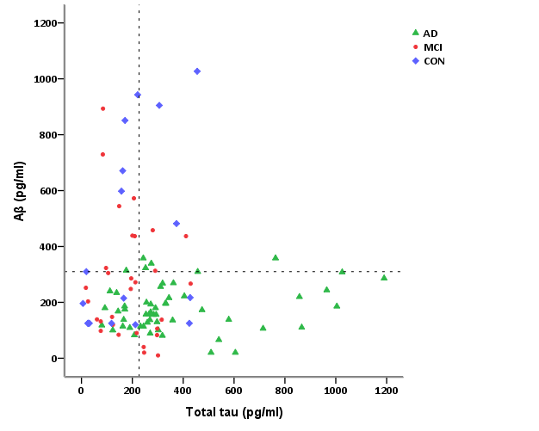
5. CSF biomarker profiles N=126: 54 AD, 30 MCI, 9 VaD, 4 LBD, 11 FTD, 18HC

Slide 48
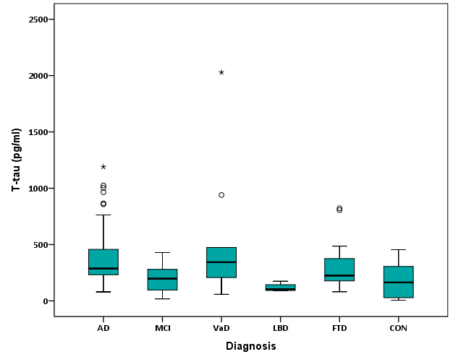
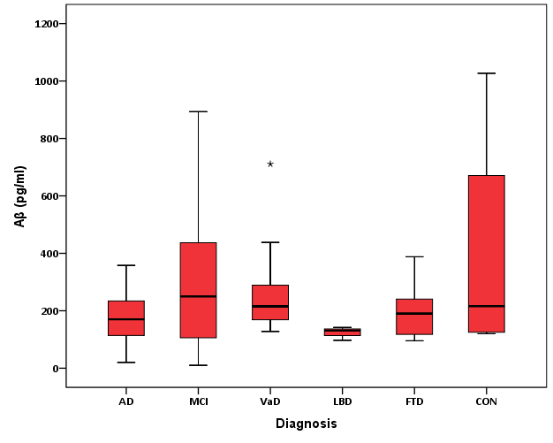
Some of our preliminary data according to clinical dg

Slide 49
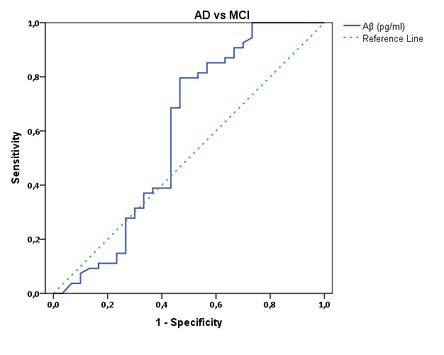
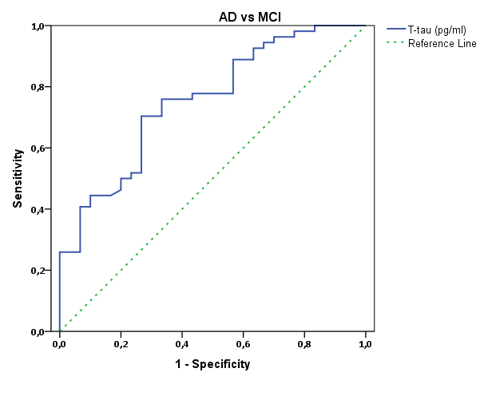
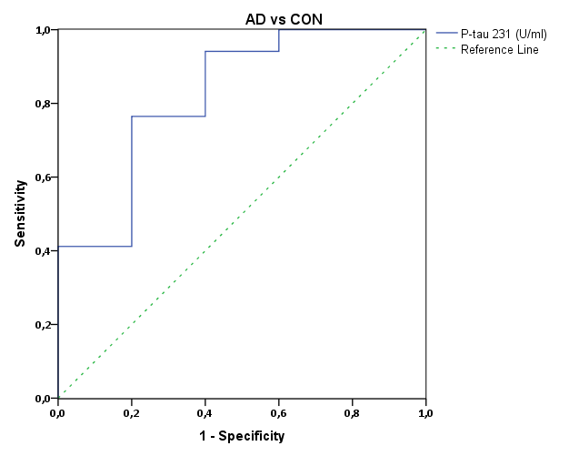
ROC analysis
AD vs CON (Number of patients) | Cut-off | Sensitivity (%) | Specificity (%) | AUC | P-value | Specificity (if sensitivity ≥ 85%)
T-tau (102) | 226,5 pg/ml | 75,9 | 72,2 | 0,744 | 0,002* | 55,6
Aβ (102) | 309,75 pg/ml | 90,7 | 44,4 | 0,661 | 0,042* | 44,4
P-tau231 (36) | 7,61 U/ml | 76,5 | 80 | 0,824 | 0,031* | 61
MCI vs AD
T-tau (102) | 249,2 pg/ml | 70,4 | 73,3 | 0,754 | <0,001* | 43,3
Aβ (102) | 245,8 pg/ml | 79,6 | 46,7 | 0,595 | 0,151 | 43,3
P-tau231 (36) | 3,76 U/ml | 88,2 | 64,3 | 0,811 | 0,003* | 64,3

Slide 50
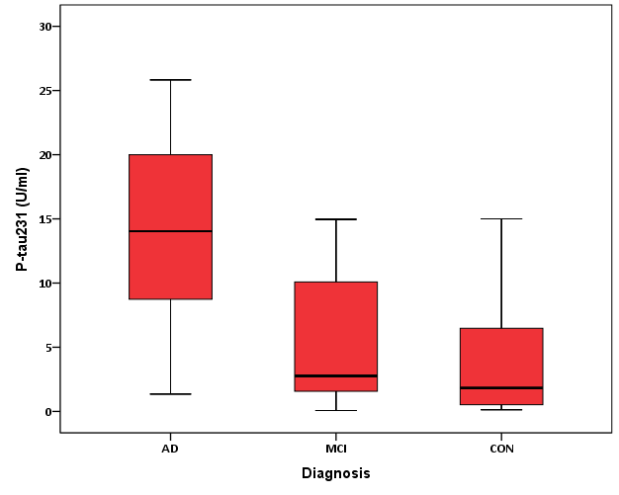
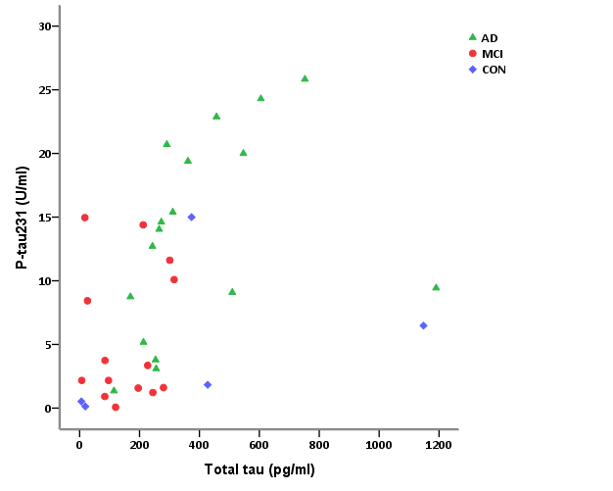
p-tau231
Significant: AD vs MCI (U=45; Z=-2,938; p=0,003) and AD vs HC (U=15; Z=-2,155; p=0,031)
Non-significant differences: MCI vs. HC (U=30; Z=-0,463; p=0,687)

Slide 51
CSF biomarkers in NDD dg summary
123
123
123
Disease | Total tau | P-tau | Aβ₁₋₄₂
AD | ↑↑ | ↑↑↑ | ↓↓
CJD | ↑↑↑ | 0 | ↓↓
FTLD | ↑ | 0 | ↑↑
DLB | ↑ | ↑ | ↓↓
VaD | ↑ | ↑ | ↓
Normal aging, PD, MDD, WKD | 0 | 0 | 0

Slide 52
Conclusions on 6 main approaches for diagnosing and monitoring potential treatments of AD
123 behavioral assessment, including measurement of cognitive status using various neuropsychological scales (MMSE, ADAS-Cog, etc.)
123 changes in brain structure (mainly volume of the cerebral cortex, particularly entorhinal cortex and hippocampus)
123 alterations in brain’s functional (fMRI) and structural (DTI) connectivity, and metabolism (FDG-PET) most notably within the default mode network
123 measurement of β-amyloid load within the brain (PIB-PET)
(FDDNP-PET - not enough data for firm conclusions)
123 CSF biomarker profiles (the three main CSF biomarkers of AD being β-amyloid, total tau, and phosphorylated forms of tau proteins)
123 post-mortem confirmation of characteristic AD histopathology.

Slide 53
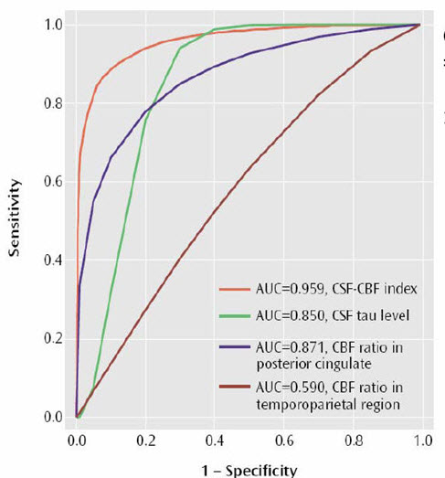
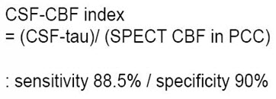
Is it possible to increase specificity and sensitivity of AD biomarkers?
Ideal biomarker
Typical biomarker
sensitivity
Zero discrimination
1 - specificity

Slide 54
3 major pitfalls of current CSF biomarkers for AD
1. The major pitfall when studying CSF biomarkers to predict AD in MCI cohorts is the fact that conversion from MCI to AD is only about 9.6% (in non-specialized institutions 12-15%) per year (in contrast, only 1-2% of healthy older population convert to AD per year), whereas the rest of MCI patients have a less progressive form of memory impairment (DeCarli, Lancet Neurol. ’03; Petersen, J. Int. Med. ’04, etc.); therefore, only an extensive follow-up time (7-10 years) of patients with stable MCI might further increase the specificity of CSF biomarkers
2. CSF biomarkers correlate better with the neuropathologic than clinical diagnosis (14-17%) (Toledo et al., Acta Neuropathol., 2012)
3. In one of the latest studies from the Alzheimer’s Association quality control program of AD biomarkers, 40 laboratories participated. Three different ELISA kits were used (Innogenetics, Biosource, Meso Scale Discovery), whereas 26 laboratories used the Innogenetics ELISA kit. Biomarkers levels differed among the laboratories with coefficient of variation (CV) ranging from 13% to 36% ! (Mattsson N. et al., Alzheimers Dement., 2011, 7, 386-395). In another study, within-laboratory CV was 5.3%, 6.7% and 10.8% for Aβ1-42, t-tau and p-tau181, respectively, while intercenter variability reaching 17.9%, 13.1% and 14.6% (Shaw L.M. et al., Acta Neuropathol., 2011, 121, 597-609).

Slide 55
Passing-Bablok analysis showed significant differences between Invitrogen and Innogenetics ELISA methods, making it impossible to use
them interchangeably!
So, future studies are still required to (i) determine cut-off levels for Aβ1-42, t-tau, and p-tau; (ii) standardize pre-analytical procedures across laboratories to account for inter-center variability; and (iii) further perform detailed comparison of ELISA kits produced by different vendors on higher numbers of subjects and samples.
Babić et al., Transl. Neurosci., 2013

Slide 56
From where Aβ originates from?
Earlier findings show that Aβ does not enter the extracellular space of CNS from serum via the vasculature, ependymal organs, or by the way of choroid plexus,
nor it is generated by astrocytes, oligodendrocytes, or microglia cells;
not all nerve cells can generated Aβ: nerve cells of the enteric and
peripheral nervous system can not do so, neither do CNS interneurons
Contrary to what has been previously thought, Aβ deposits are seen later than intraneuronal neurofibrillary (tau) changes (Braak and Del Tredici, Neurobiol. Aging, 2004; Schnheit et al., Neurobiol. Aging 2004; Braak et al., Acta Neuropathol., 2013, in press)!
The most likely candidates for generating Aβ are chiefly projecting neurons of brainstem nuclei in which abnormal tau inclusions are present that commence production of Aβ deposits and which have long axons with diffuse projections (with non-juctional varicosities, and only a few classical synaptic boutons with pre- and postsynaptic thickening) to the cerebral cortex (e.g. the existence of Aβ plaques in the cerebellum can only be explained by such a phenomenon as the neurons of the cerebellum itself do not develop tau-associated lesions)
Such a mechanism where projecting axons similarly innervate cells of the vasculature (amyloid angiopathy) would also explain why Aβ plaques are found only in CNS;
NA-gic terminals correspond best with Aβ plaque deposition in CCx and AA, while terminals of the upper raphe nuclei may be responsible for Aβ plaques in striatum;
Both systems are necessary for DMN f-on! Is Aβ just the consequence, not the cause of AD?
Braak and Del Tredici, Acta Neuropathol., 2013, 126, 303-306; Braak et al., Acta Neuropathol., 2013, in press

Slide 57
Thank you for your attention
Croatian Science Foundation
Detection and tracking of biological markers for early therapeutic intervention in sporadic Alzheimer's disease
Project of the Croatian Science Foundation grant no. 09/16, lasting from 1st Jan 2012 - 31st Dec 2014
For new developments please visit our web page
http://alzbiotrack.hiim.hr

Slide 58
Collaborators
Croatian Science Foundation
Project no. 09/16 (2012-2014)
Matea Nikolac, Nela Pivac, Dorotea Mück Šeler, Gordana Nedić, Maja Mustapić, Mirjana Babić, Fran Borovečki, Dubravka Švob Štrac, Maja Jazvinšćak Jembrek, Sanja Hajnšek, Ratimir Petrović,
Svjetlana Kalanj Bognar, Željka Vukelić, Patrick R. Hof,
Milan Radoš, Ninoslav Mimica, Paola Presečki, Danira Bažadona, Nataša Jovanov Milošević, Gabrijela Stanić, Neven Henigsberg
Croatian Science Foundation

