Slide 1
Neuropathology of Alzheimer’s disease
Prof. Goran Šimić MD, PhD
Dept. Neuroscience
Croatian Institute for Brain Research
Medical School Zagreb
University of Zagreb
COST CM1103
Structure-based drug design for diagnosis and treatment of neurological diseases: dissecting and modulating complex function in the monoaminergic systems of the brain
Bruxelles, 2 Feb 2012
Croatian
Science
Foundation
Grant no. 09/16

Slide 3
Some facts about AD
Alzheimer’s disease (AD) is a chronic degenerative disease and by far the most frequent primary cause of dementia in the elderly (over 50,000 people in Croatia and over 25 million people worldwide).
Recent figures from Alzheimer’s Disease International (ADI) estimate that in 2010, AD cost the world economy 1% of its global GDP (444 billion euros).
It is expected that AD overall prevalence will quadruple to 106 million by 2050; thus dementia will be one of the main health issues of the next decades and the need for effective treatments is urgent.

Slide 4
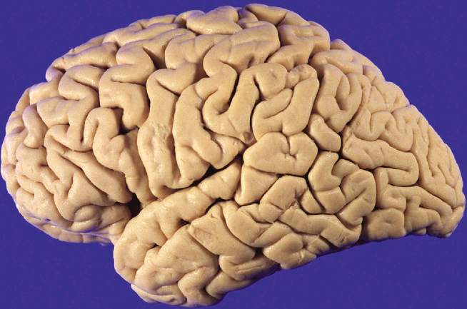
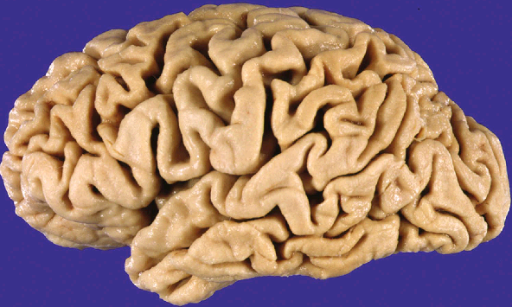
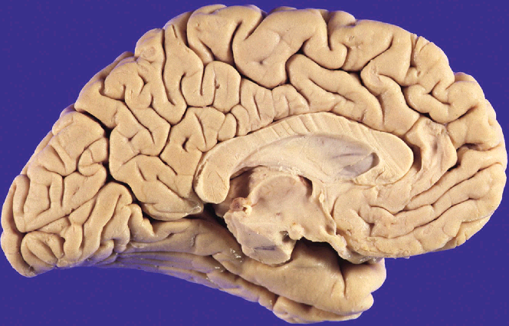
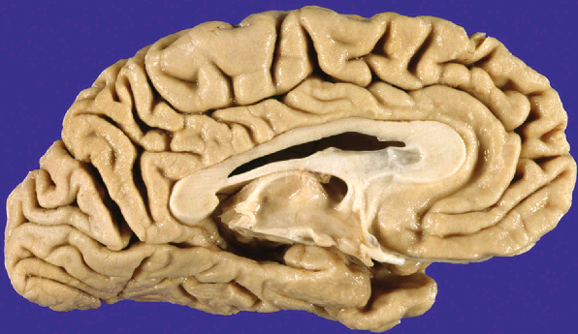

Slide 5
Normal (73 y.) vs. AD brain (73 y.)

Slide 6
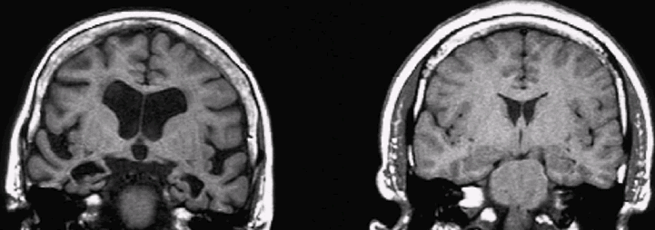

Slide 7
AD (70 y.) vs normal brain (70 y.)
MRI

Slide 8
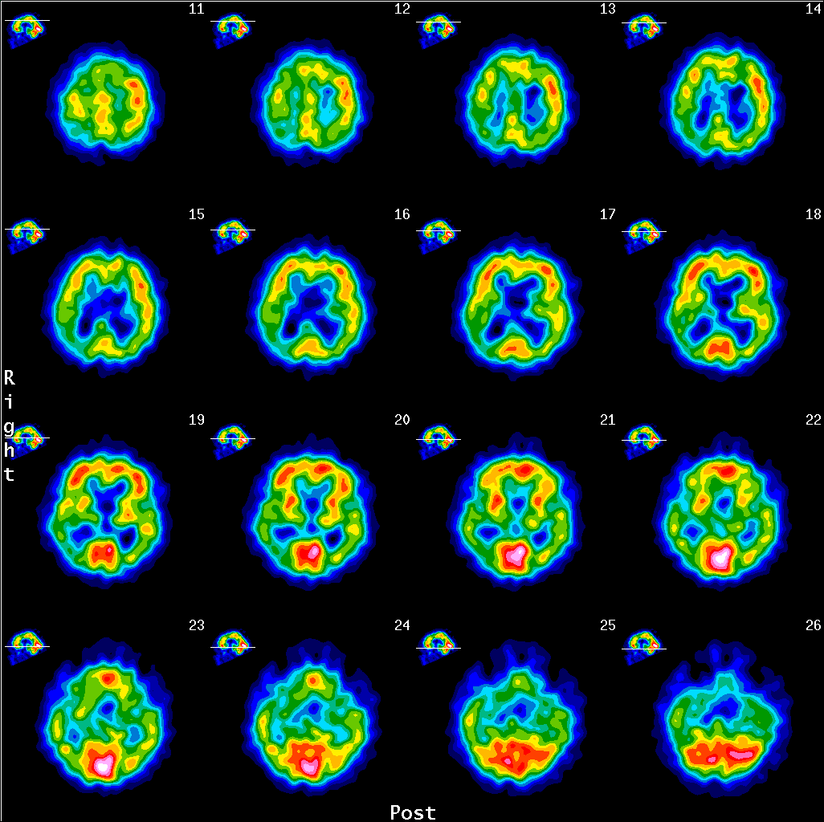

Slide 9
AD – parieto-temporal hypometabolism
(FDG PET UHC Zagreb)
Courtesy of dr. Ratimir Petrović

Slide 10
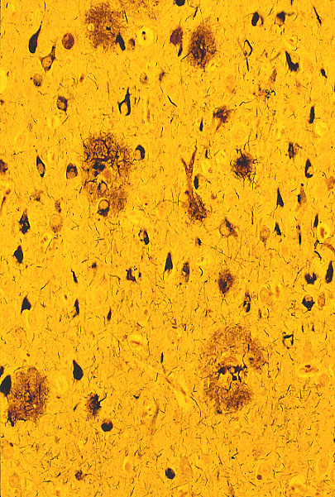
AD – basic pathology

Slide 11
AD – basic pathology
Neuritic plaque (NP)
Neurofibrillary
tangle (NFT)
Plaques and tangles

Slide 12
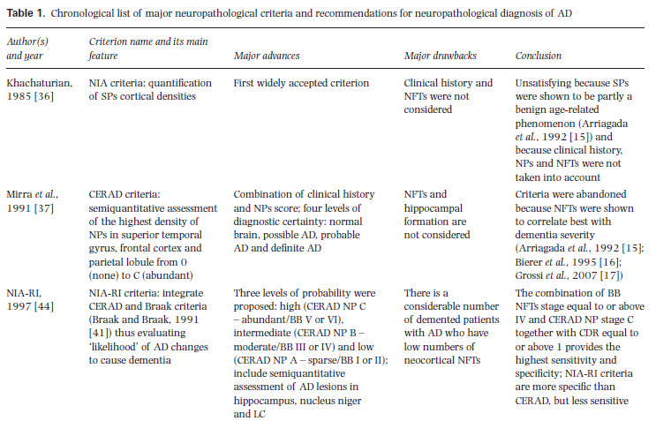
Neuropathological criteria for AD

Slide 13
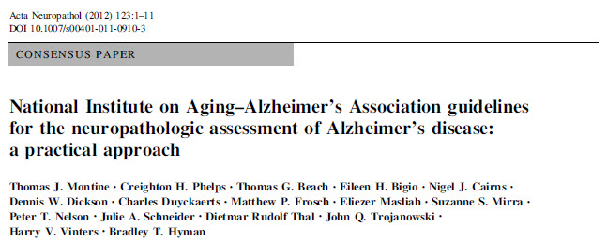
Newest neuropathological
AD criteria (Jan 2012)

Slide 14
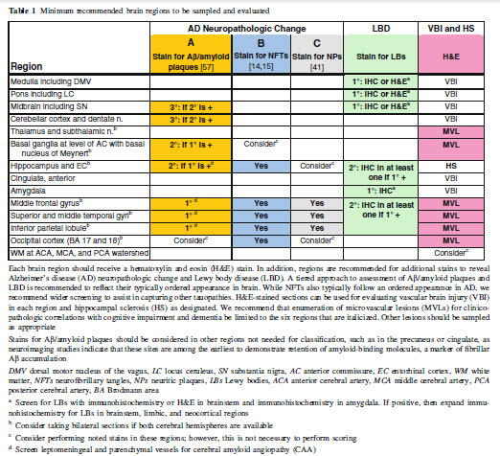
Newest neuropathological
AD criteria (Jan 2012)

Slide 15
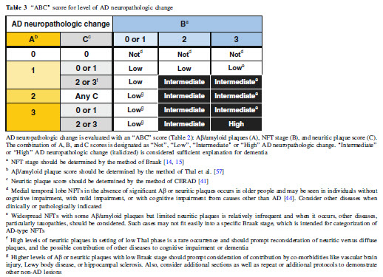
Newest neuropathological
AD criteria (Jan 2012)

Slide 16
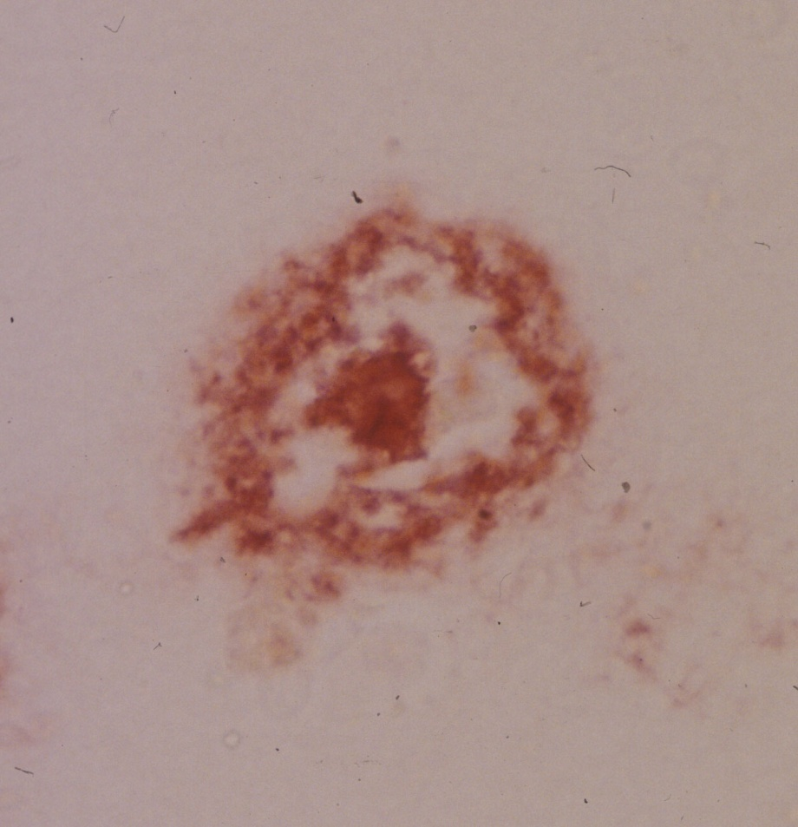
George Glenner and Cai’ne Wong’s isolation of A-beta
- the problem was how to dissolve
amyloid (and not break it apart) since it could not be dissolved by using known solvents and detergents (SDS)
- they used Congo red (apple green color seen through the polarizing microscope) for visualization of the vascular amyloid (to collect it in a greater amount) and a chaotropic salt to dissolve it
- after having 2 peptides (alpha and
beta) they proceeded with the later (that was in a larger amount) and revealed 24aa stretch
- antibody against the A-beta (raised by Vito Quaranta) recognized both amyloid in blood vessels and SP
1984
Glenner GG, Wong CW. Alzheimer's disease: Initial report of the purification and characterization of a novel cerebrovascular amyloid protein. Biochem Biophys Res Commun 1984;120:885-90.

Slide 17
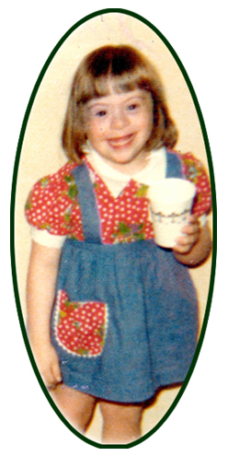
Colin Masters, Konrad Beyreuther et al. sequenced A-beta from SP of AD and DS
Masters Cl, Simms G, Weinmann N, Multhaup G, McDonald B, Beyreuther K. Amyloid plaque core protein in Alzheimer disease and Down syndrome. Proc Natl Acad Sci USA 1985;82:4245-9.

Slide 18
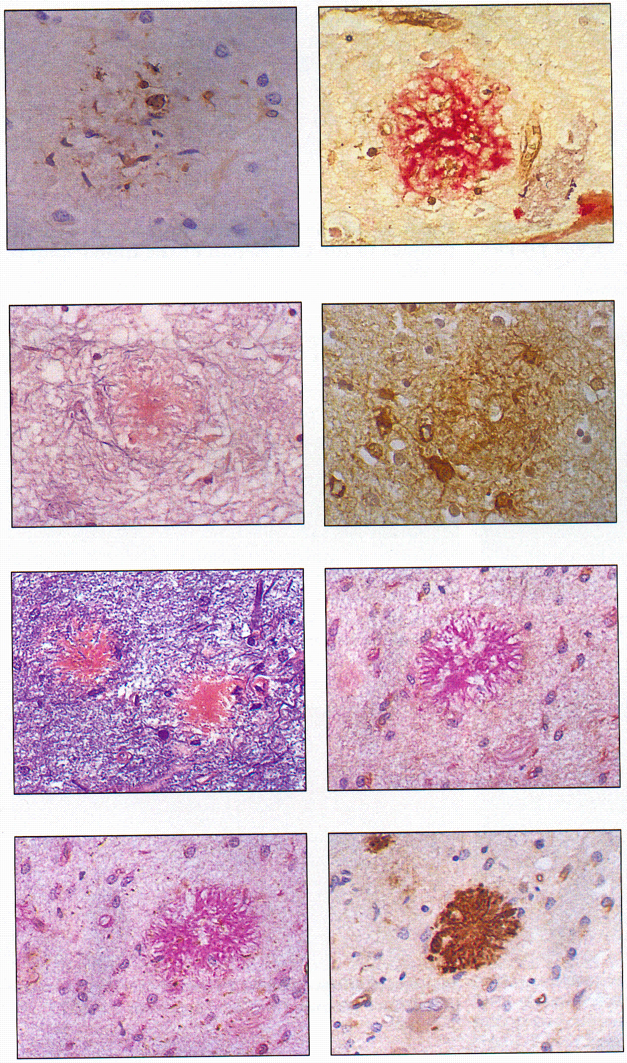
Glenner and Wong’s confirmed that A-beta in AD and Down sy are identical
AD
DS
Glenner GG, Wong CW. Alzheimer's disease and Down's syndrome: Sharing a unique cerebrovascular amyloid fibril protein. Biochem Biophys Res Com 1984;122:1131-5.

Slide 19
After Lester Binder discovered tau proteins in 1985,
First, in 1986, it was confirmed that NFTs contain tau:
And then, after identification of tau gene in 1987 on chr 17, in 1988, Michael Goedert has shown that the cores of NFT are made up of tau:
Nukina N, Ihara Y. One of the antigenic determinants of PHFs is related to
tau protein. J Biochem 1986;99:1541-4.
Goedert M, Wischik CM, Crowther RA, Walker JE, Klug A. Cloning and
sequencing of the cDNA encoding a core protein of the PHF of Alzheimer
disease: identification as the microtubule-associated protein tau. PNAS
1988;85:4051-5.

Slide 20
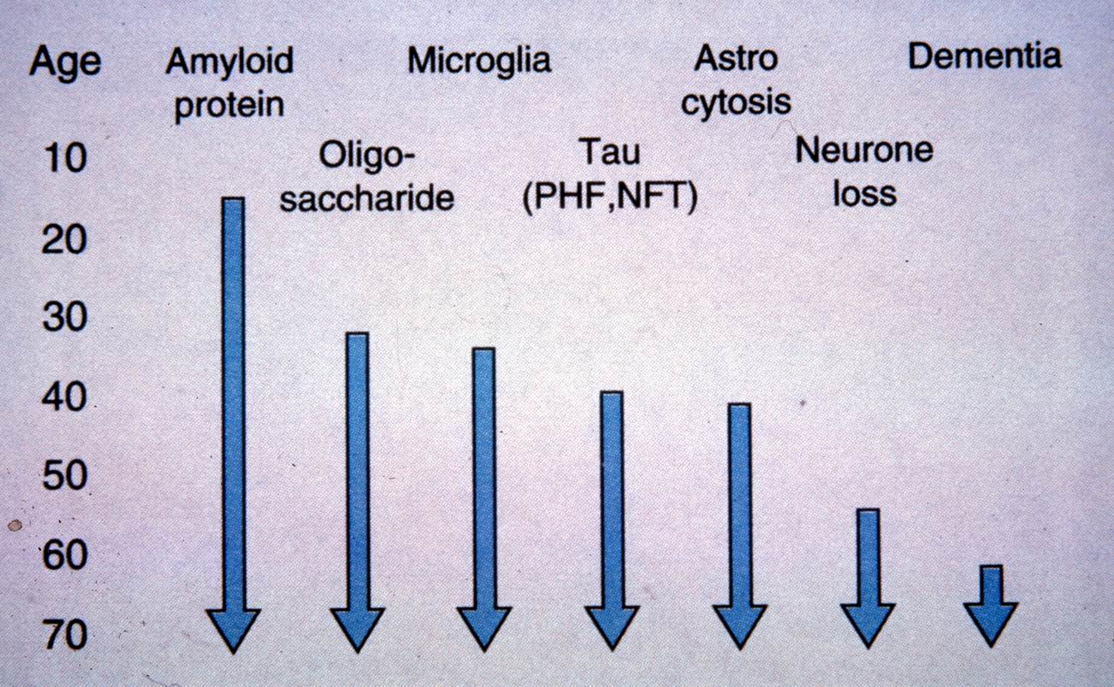
Dmitry Goldgaber isolated APP and localized its gene to chr 21
Due to an extra copy of the APP gene DS patients develop very early not only characteristic AD pathological changes but dementia as well.
1987
Goldgaber D, Lerman MI, McBride OW, Saffiotti U, Gajdusek C. Characterization and chromosomal localization of a cDNA encoding brain amyloid of Alzheimer’s disease. Science 1987;235:877-80.

Slide 21
However, most of the other linkage studies have shown that the APP was not linked to FAD!
Peter St. Hyslop shown linkage of 4 FAD families to chr 21
St George-Hyslop PH, Tanzi RE, Polinsky RJ, Haines JL, Nee L, Watkins PC. The genetic defect causing familial Alzheimer's disease maps on chromosome 21. Science 1987;23: 885-90.

Slide 22
This finding supported the view of hematogenic origin of A-beta (i.e. that A-beta is primarily produced outside the brain), and encouraged the search for APP mutations that cause AD, so that finally ...
Later same year: first APP mutation
associated with a disease: HCHWA-D
Van Broeckhoven C, Haan J, Bakker E. Amyloid beta protein precursor gene and hereditary cerebral hemorrhage with amyloidosis (Dutch). Science 1990; 248: 1120-2.
Levy E, Carman MD, Fernandez-Madrid IJ, i sur. Mutation of the Alzheimer's disease amyloid gene in hereditary cerebral hemorrhage, Duch type. Science 1990; 248: 1124-1126.

Slide 23
1991: Report of the first Alzheimer gene mutation (in APP)!
Goate A, Chartier-Harlin MC, Mullen M, Hardy J. Segregation of a missense mutation in the amyloid presursor protein gene with familial Alzheimer's disease. Nature 1991;349: 704-6. (on Allen Roses’ blood samples from Duke University)

Slide 24
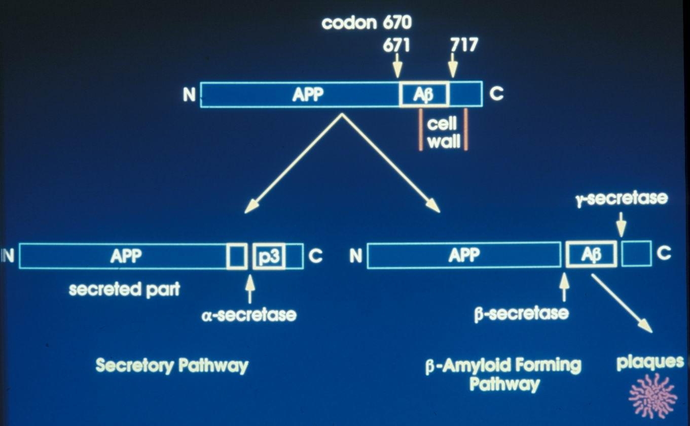
Amyloid cascade hypothesis 1990
Esch FS, Keim PS, Beattie EC. Cleavage of amyloid beta peptide during constitutive processing of its precursor. Science 1990;248:1122-4.
Sisodia SS, Koo EH, Bayreuther K, Unterbeck A, Price DL. Evidence that beta-amyloid protein in Alzheimer’s disease is not derived by normal processing. Science 1990;248:492-5.

Slide 25
Amyloid cascade hypothesis 2010
2. PS-1: Schellenberg GD, Bird TD, Wijsman EM, Orr HT, Anderson L, Nemens E. Genetic linkage evidence for familial Alzheimer's disease locus on chromosome 14. Science 1992;115:735-48.
4. PS-2: Levy-Lahad E et al. Candidate gene for the chromosome 1 familial Alzheimer’s disease locus. Science 1995;269:973-977 & Rogaev EI et al. Familial Alzheimer’s disease in kindreds with missense mutations in a gene on
chromosome 1 related to Alzheimer’s
disease type 3 gene. Nature 1995;376:
775-8. (Volga German families)
3. APOE (chromosome 19): Corder EH, Saunders AM, Strittmatter WJ. Gene dose of apolipoprotein E type 4 allele and the risk of AD in late onset families. Science 1993; 261:
828-9.
5. CO-I & II: Mattson MP. Mother's
legacy: Mitochondrial DNA mutations and Alzheimer's disease. TINS 1997;20:373-5.
Wolfe MS, Selkoe D. Two transmembrane aspartates in PS-1 required for endoproteolysis and gamma-secretase activity. Nature 1999;398;513-7.
Vassar R et al. Beta-secretase cleavage of Alzheimer’s APP by the transmembrane aspartic protease BACE (beta site APP cleaving enzyme). Science 1999;286:735-41 (Amgen)
ADAM family of metaloproteases (e.g. TACE, TNFα-converting enzyme)
BACE or memapsyn-2
Buxbaum JD, Liu KN, Luo YX. Evidence that TNF alpha
converting enzyme is involved in regulated alpha-secretase
cleavage of the Alzheimer APP. JBC 1998;273:27765-7.
Lammich S, Kojro E, Postina R. Constitutive and
regulated alpha-secretase cleavage of Alzheimer’s
APP by a disintegrin metalloprotease. PNAS 1999;96:3922-7.
Hussain I, Powell D, Howlett DR. Identification of a novel aspartic protease Asp
2 as beta-secretase. Mol Cell Neurosci 1999;14:419-27. (SmithKlineBeecham)
Sinha S, Anderson JP, Barbour R. Purification and cloning of APP beta-secretase
from human brain. Nature 1999;402:537-40.

Slide 26
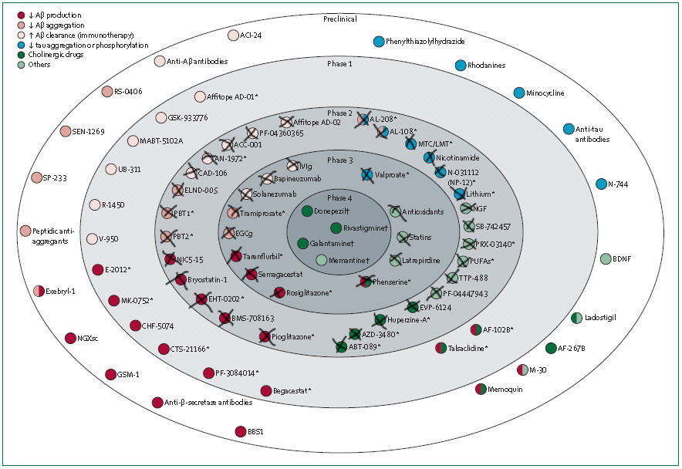
1993 tacrine, 1997 donepezil, 2000 rivastigmin, 2001 galantamin; 2003 memantin

Slide 27
All of the aforementioned drugs:
Showed promise in animal studies
Showed promise in early human trials
BUT...
Were discontinued at late stages
WHY (i.e. how they manage to progress to this stage)?

Slide 28
So, why are drug trials in AD failing?
The failure of the translation of research is attributable mainly to:
Use of models that do not accurately reflect human pathogenesis
Poor methodology in animal studies
Innacurate prediction of drug efficacy in animal models
Fact that neutral or non-significant animal studies are less likely to be published
Most importantly, due to wrong premises i.e. hypotheses on which most AD trials are based

Slide 29
http://www.nia.nih.gov/Alzheimers/Resources/ProgressReportImages.htm
WRONG PREMISE 1: Amyoid is a primary wrongdoer
Amyloid cascade hypothesis
- supported by genetics
in familial cases
(approx. only 0.45%
of all cases!!!)
Tau hypothesis
- supported by clinico-pathological correlations in both
known genetic and sporadic cases (approx. 4% w/o amyloid pathology)

Slide 30
Is amyloid hypothesis dead?
All trials of potential AD-modifying drugs based on manipulation of beta-amyloid failed
In the recent abandoned gamma secretase inhibitor semagacestat trial, patients on the drug even got worse i.e. the drug, which was designed to inhibit formation of beta-amyloid, speeded up cognitive decline
Many authors, such as Mangialasche et al. (Lancet Neurol. 2010) concluded that “the one protein, one drug, one disease hypothesis used as a basis of most AD therapy studies need to be revised”
Instead, as with many other chronic diseases “we need multiple approaches to modify the disease process, starting in mid-life (e.g. hypertension control and the lowering of homocysteine early in the disease process)”

Slide 31
Jost BC, Grossberg GT. The natural history of Alzheimer's disease: a brain bank study.
a retrospective review of 100 autopsy-confirmed AD cases found that, on average, depression, mood change, social withdrawal and other BPSD were documented more than 2 years before the diagnosis of AD was made
(the earliest noncognitive symptom appeared, on average, 33 months before diagnosis)
J. Am. Geriatr. Soc. 1995; 43: 1248-1255.

Slide 32
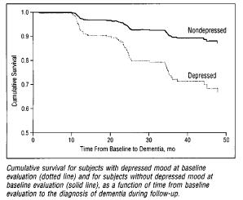
study comprised of 1070 nondemented individuals, those who had depressed mood at baseline were found to have an increased relative risk of dementia of 2.94 (even after adjustments made for age, gender, educational level and language)

Slide 33
a longitudinal study of 235 patients with early probable AD:
only 8.5% were free of noncognitive, BPSD such as disturbances in mood, emotion, appetite and wake–sleep cycle, ‘sundowning’, confusion, agitation, depression and others, during the first 3 years of follow up

Slide 34
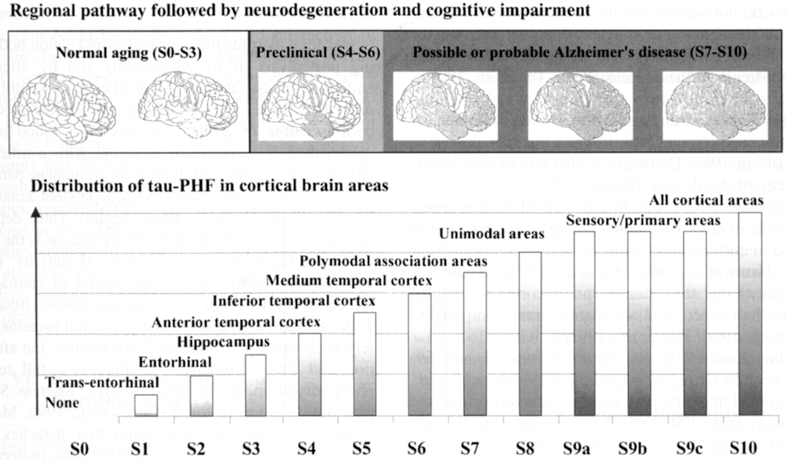
NIA-RI neuropathological criteria for AD (Reagan Institute, 1997)
Reconciliate the amyloid cascade hypothesis with the major role of NFTs in clinico-pathological correlations
Include semiquantitative assessment of AD lesions in hippocampus, susbstantia nigra and locus coeruleus
Integrate CERAD and Braak staging evaluating “likelihood” AD changes led to dementia (Braak and Braak, Acta Neuropathol 1991; Neurobiol Aging. 1997;18(4 suppl):S1-2.)
High - CERAD frequent / Braak V or VI
Intermediate - CERAD moderate / Braak III or IV
Low - CERAD sparse / Braak I or II
Major weakness:
Since there is a considerable number of demented patients with AD who have low numbers of neocx NFTs NIA-RI criteria are more specific than CERAD, but LESS SENSITIVE

Slide 35
Re-search by Braak et al.
Later same year, Braak and colleagues confirmed very early AD-related cytoskeletal changes in the DRN in 27 AD cases. Moreover, they claimed that in accordance with the cross-sectional data available to them, “the rostral raphe group, is affected as early as in stage I – some 30 years prior to dysmnesia (!!!) – by the AD-related cytoskeletal lesions”.
Rüb U, Del Tredici K, Schultz C, Thal DR, Braak E, Braak H. The evolution of Alzheimer’s disease-related cytoskeletal pathology in the human raphe nuclei. Neuropathol. Appl. Neurobiol. 2000; 26: 553–67

Slide 36
the typical picture of an Alzheimer patient involves
Besides a progressive decline in memory function and
a gradual retreat from (and frustration with) normal activities
many additional clinical symptoms that have been described as BPSD (in roughly decreasing order):
apathy and mood disturbances
agitation or irritability
emotional disturbances, including aggression (verbal>physical)
anxiety
sleep disturbance, including sundown syndrome in the late afternoon
dysphoria
disinhibition
social withdrawal and symptoms of depression
decreased appetite (+/- weight loss)
hallucinations (visual>auditory>>tactile,olfactory)

Slide 37
Microtubule-associated protein tau
Serve both to stabilize MTs against disassembly and to mediate their
interaction with other cell components
Based on sequence analysis, MAPs are grouped in 2 types:
TYPE I MAPs: MAP1A and MAP1B (long cross-bridge “arms” between MTs in axons)
- contain KKEX binding site for tubulin
TYPE II MAPs: MAP2A and MAP2B (high mw) (cross-link MTs in dendrites)
MAP2C and MAP2D (low mw)
non-neuronal MAP4
tau (short, 18-nm-long cross-bridge “arms” between MTs in axons)
- contain 3 or 4 repeats of an 18aa residue in MTs binding domain
During development axonal MAPs are primarily tau and MAP1B

Slide 38
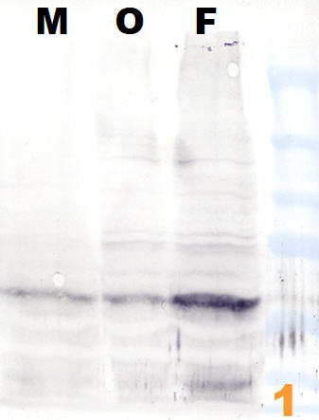
Tau phosphorylation during development
M=midbrain
O=occipital lobe
F=frontal lobe
AT8 MAb reacts with tau only when multiple sites around Ser202, including Ser199, Ser202 and Thr205, are phosphorylated.
AT8
human
AT8 WB
11 w.g.

Slide 39
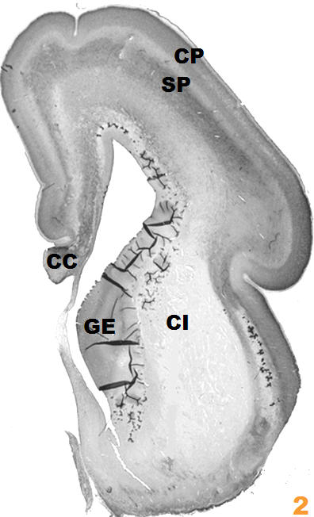
Tau phosphorylation during development
CP=cortical plate
SP=subplate
CC=corpus callosum
GE=ganglionic eminence
CI=internal capsule
Prominent AT8-ir in the lower subplate zone of the frontal regions of the telencephalon
human
WB
18 w.g.
AT8 ICC

Slide 40
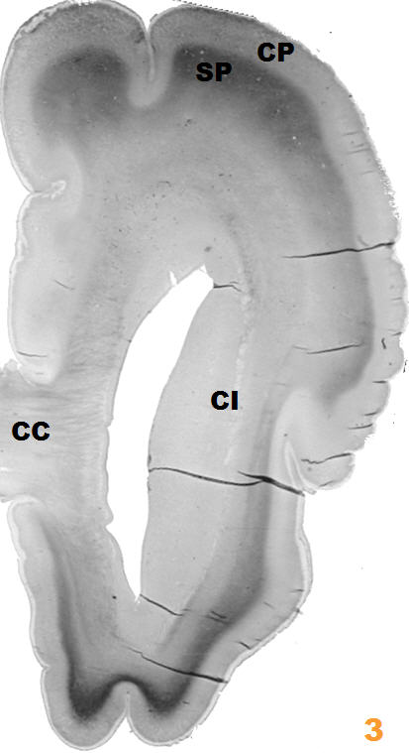
Tau phosphorylation during development
CP=cortical plate
SP=subplate
CC=corpus callosum
CI=internal capsule
AT8-ir move from lower to upper subplate; it then gradually appear in cortical plate, diminishing and disappearing completely from subplate to the end of 32nd w.g., suggesting that this phosphorylation of tau is most pronounced in a distal part of growing cortical afferents
human
20 w.g.
AT8 ICC

Slide 41
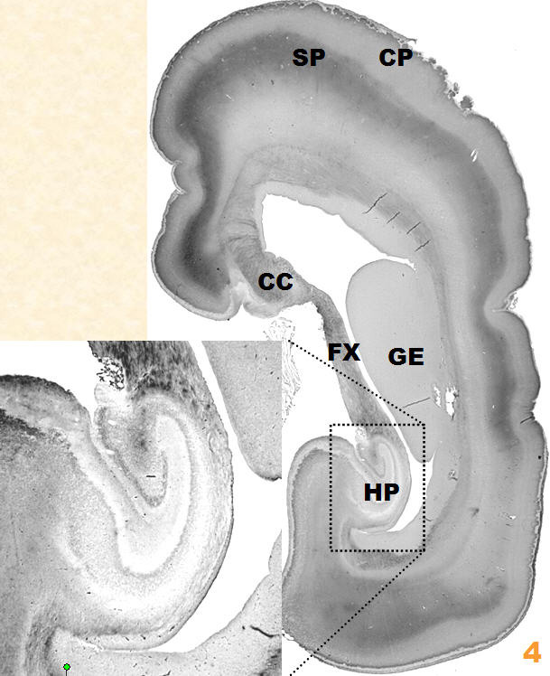
Tau phosphorylation during development
CP=cortical plate
SP=subplate
CC=corpus callosum
GE=ganglionic eminence
HP=hippocampal formation
FX=fornix
During mid-gestation, the fornix as well as a subset of callosal commissural fibers were unambiguously AT8-ir, while hippocampal formation as well as the internal capsule, remained unstained
human
22 w.g.
AT8 ICC

Slide 42
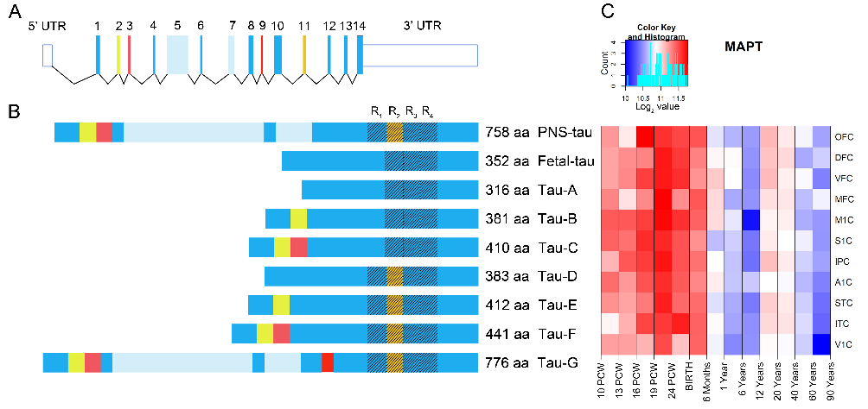
TAU expression

Slide 43
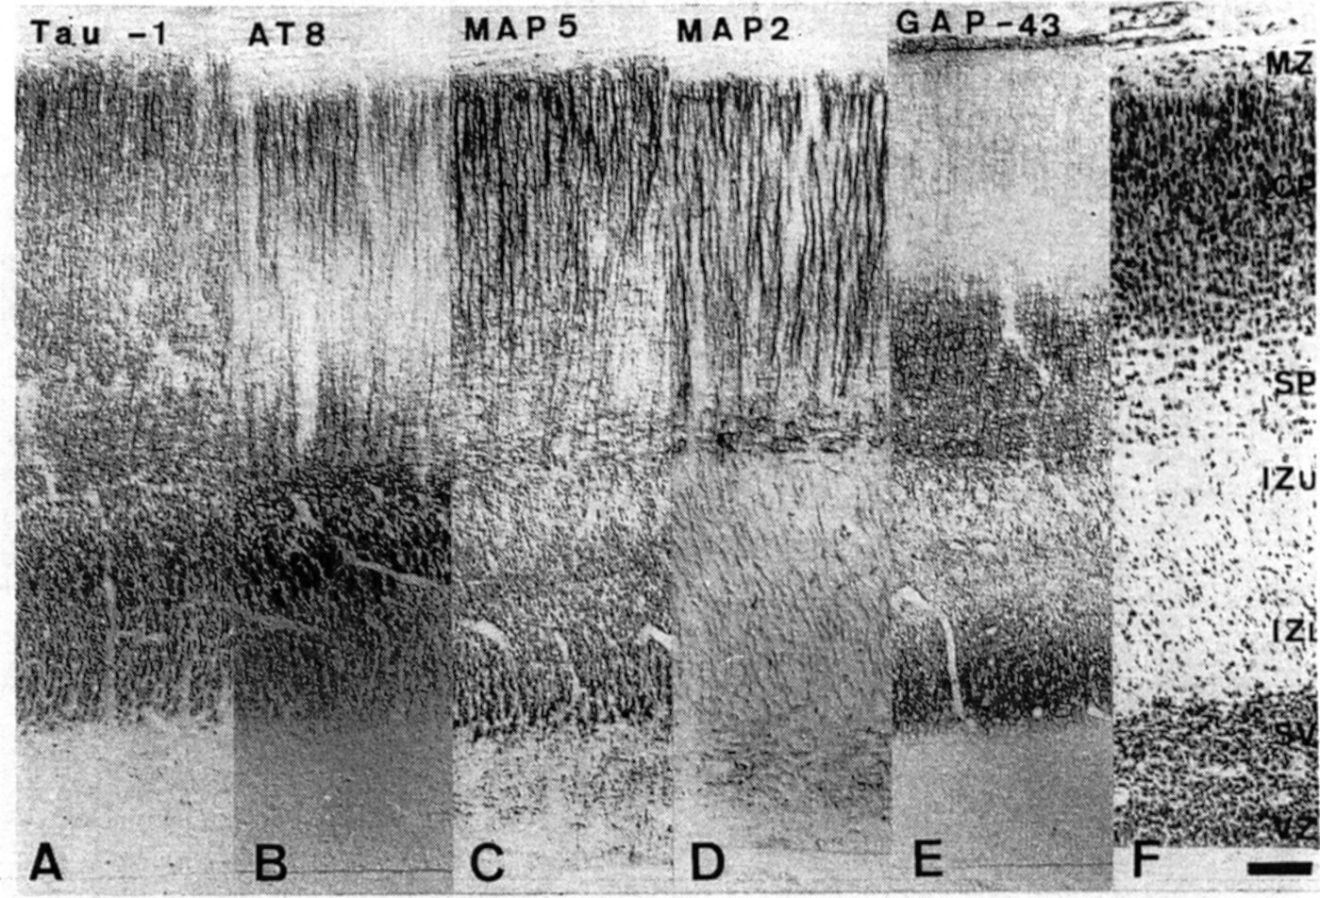
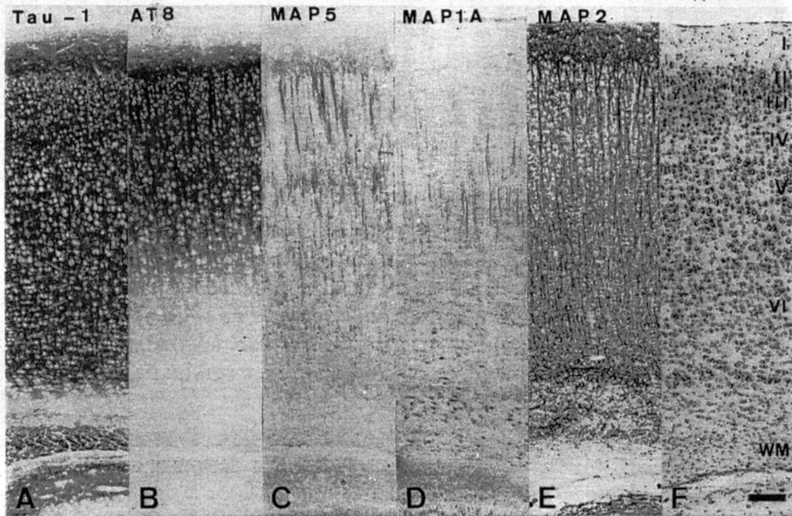
Nissl
Transient expression of phosphorylated fetal tau (occ. cx)
AT8-ir is present in axons, perikarya and dendrites of neurons
Phosphorylated tau is present at a high level only during the period of intensive axon outgrowth
It dissapears during axon stabilisation and intensive synaptogenesis, concomitant with the expression of adult tau isoforms
AT8-ir dissappears first from WM tracts and ontogenetically oldest neurons, particularly SP neurons
E20
Nissl
rat
P13

Slide 44
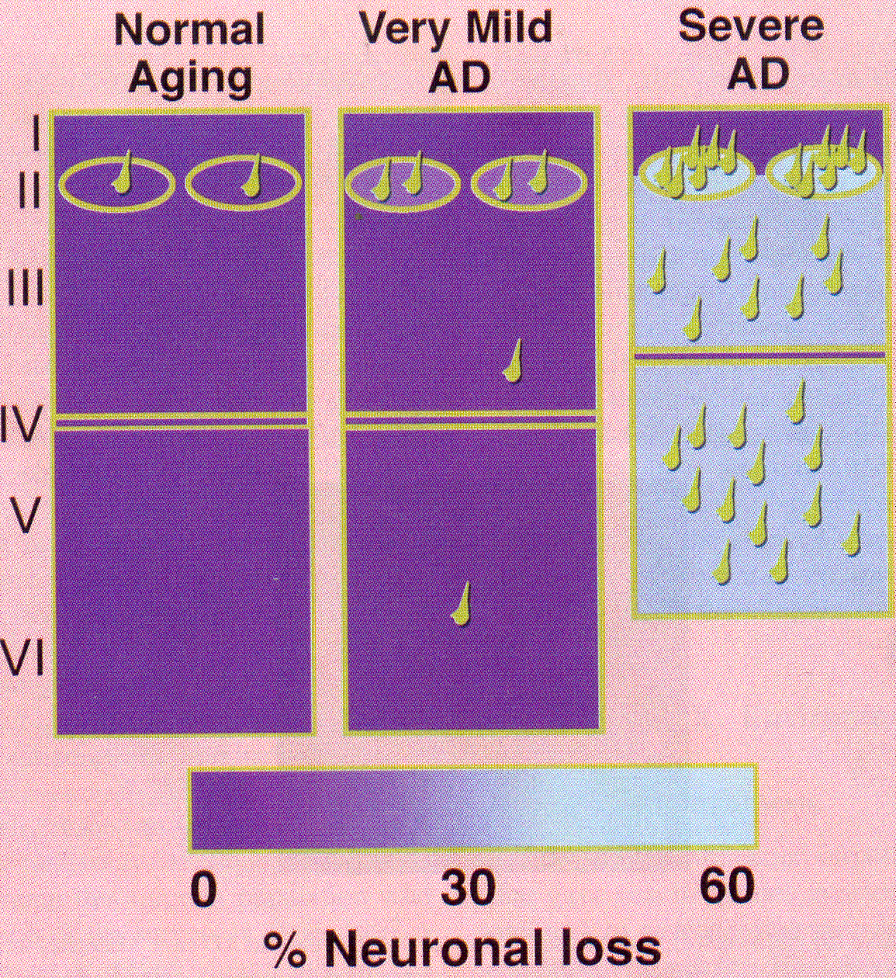
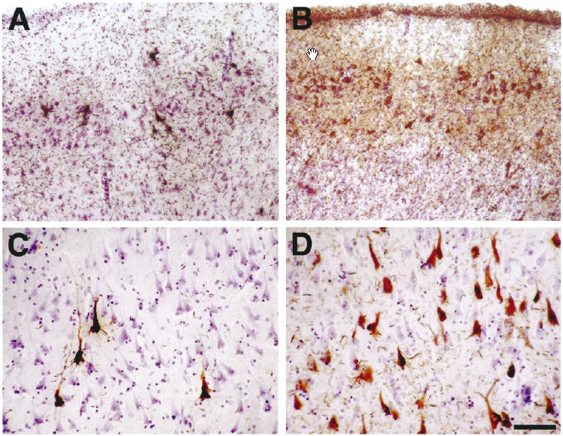
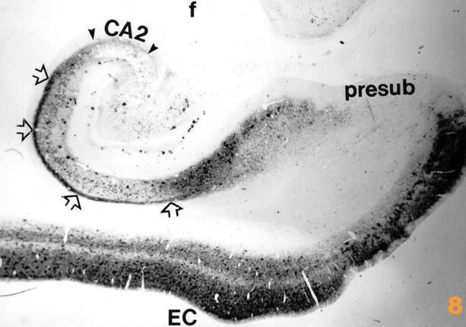
Phosphorylation of tau proteins is developmentally regulated
Phosphorylation of tau is high in the fetal period (Riederer et al., ‘01) and decreases with advancing age mainly due to phosphatases activation (Mawal-Dewan et al. ‘94; Dudek & Johnson ‘95; Rösner et al., ‘95)
However, after about 35 years of age plasticity burden in entorhinal cortex and hippocampus, together with additional genetic (APP, PS-1, PS-2, CO-I, CO-II, APOE…) and environmental (head trauma) factors that interfere with synaptic plasticity, cause the phosphorylation of tau to increase again
‘Normal’ aging (brain of cognitively normal subject)
Hof et al. ‘04
AT8 ICC
ECx
CA1

Slide 45
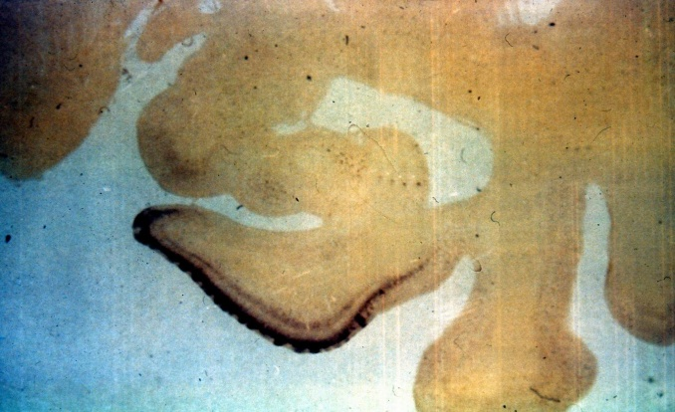
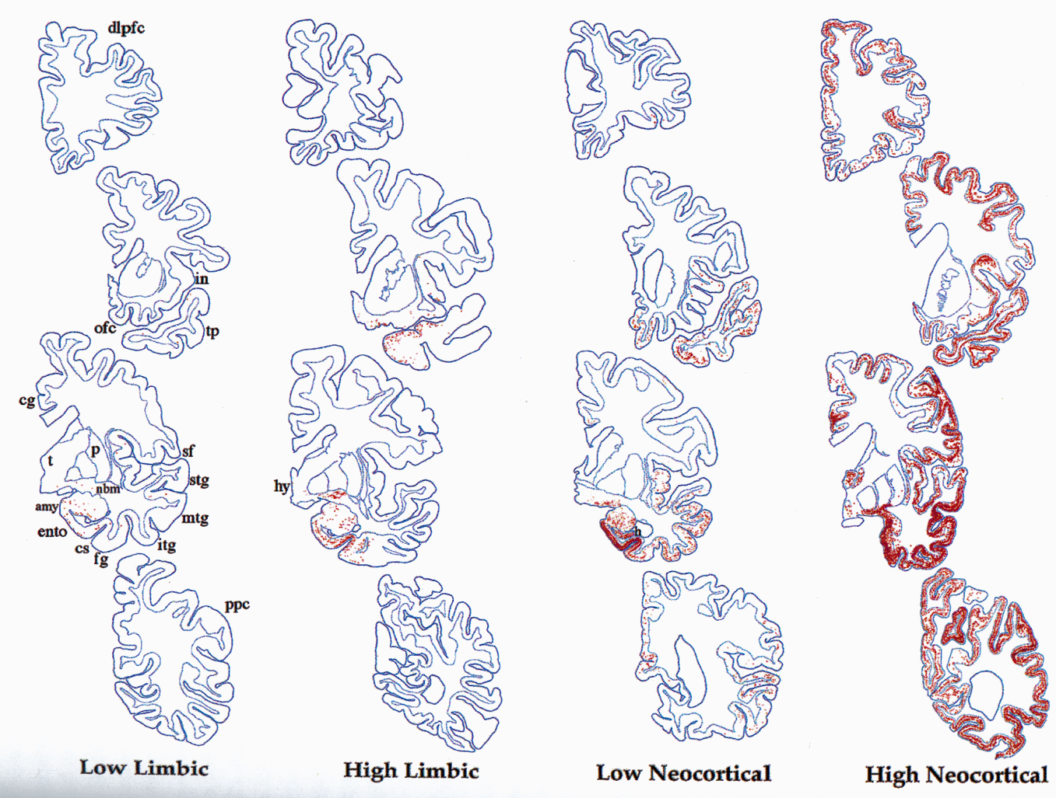
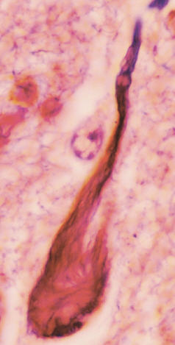
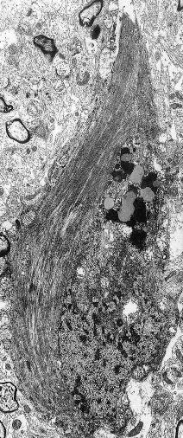
Predilection sites and spreading of neurofibrillary degeneration in Alzheimer’s disease
Mesulam
Braak
AT8 ICC
Kidd
Kidd

Slide 46
Tau phosphorylation in Alzheimer’s disease
1. In AD phosphorylation of tau is increased, both in terms of the numbers of sites phosphorylated, and the extent of phosphorylation at certain sites
2. Conformational changes occur involving either changes in folding, or formation of dimers or oligomers of tau

Slide 47
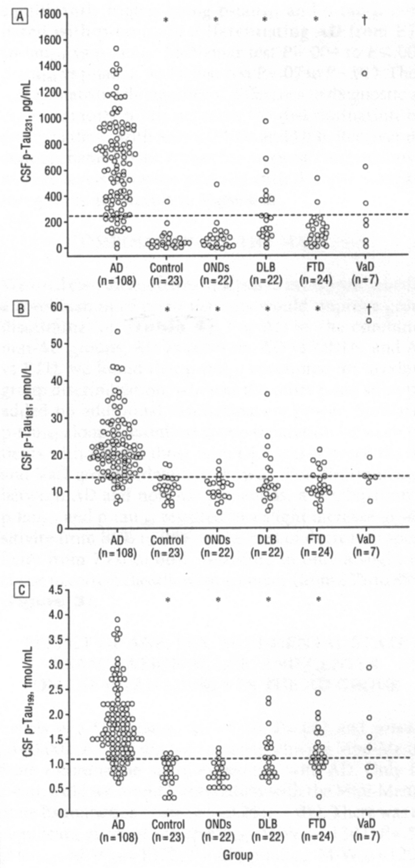
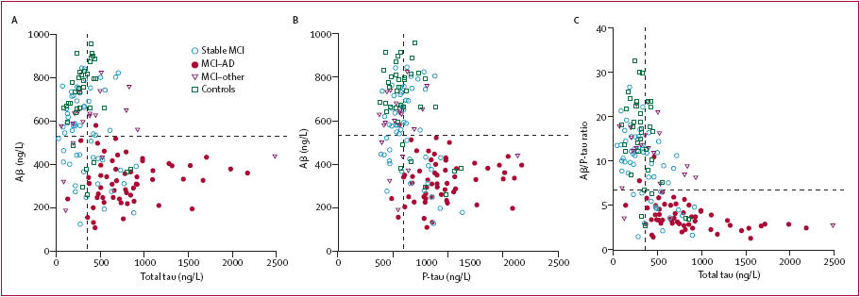
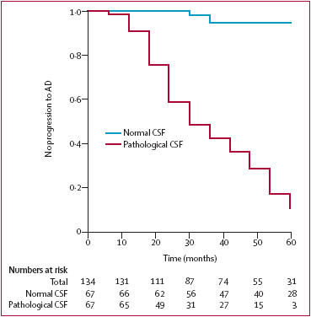
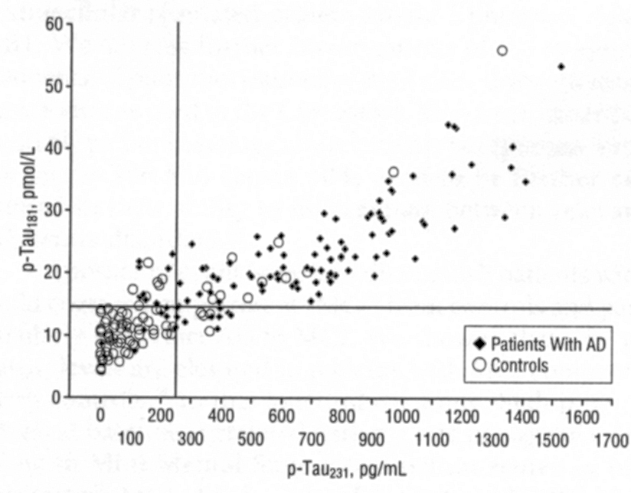
Tau phosphorylation in AD – CSF changes
Hansson et al.
Lancet Neurol ‘06
Hampel et al. Arch Gen Psychiatr ‘04
Phosphorylated tau proteins are the most
promising biological markers of AD!

Slide 48
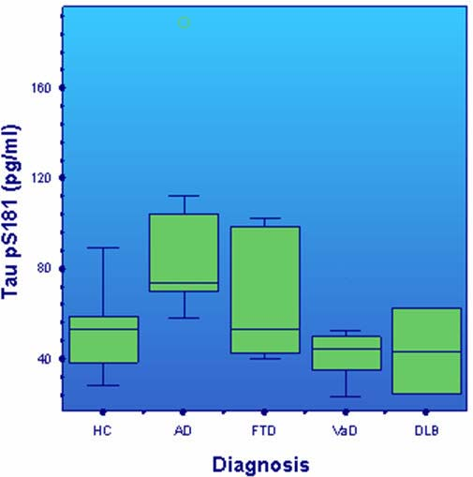
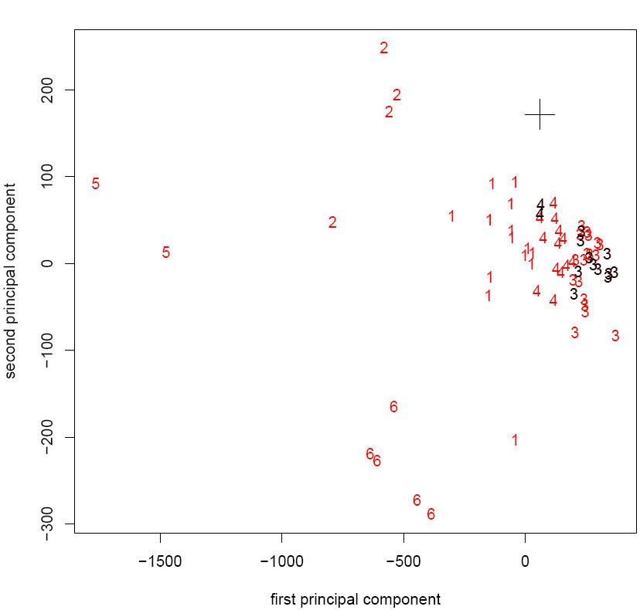
Multidimensional cluster analysis using all available biological and psychometric data
P-tau S181 AD vs DLBD: 91% sens. 94% specif.
T-tau AD vs VD: 91% sensitivity, 95% specificity
1 AD, 2 CBD, 3 FTD, 4 VaD, 5 MCI, 6 ND

Slide 49
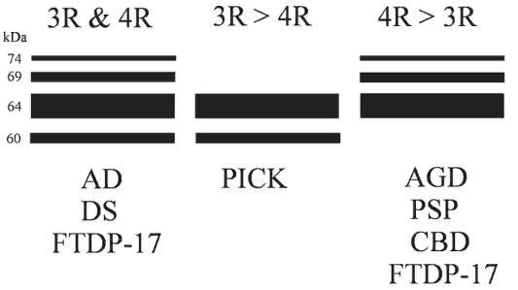
.. this helps making a proper diagnosis of a given neurodegenerative disease

Slide 50
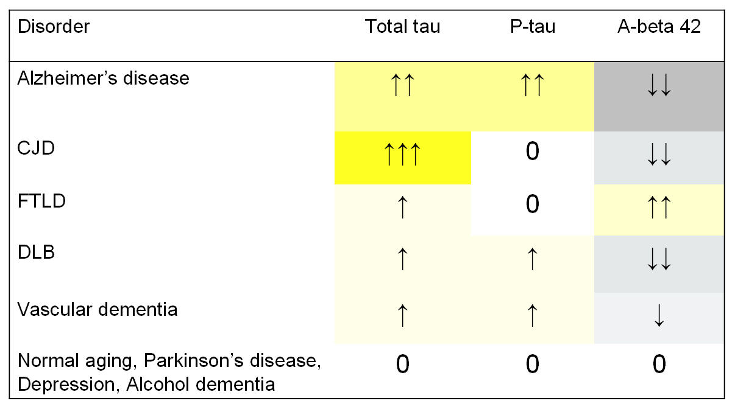
Summary on csf

Slide 51
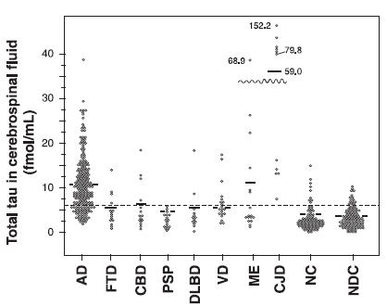
Cave!

Slide 52
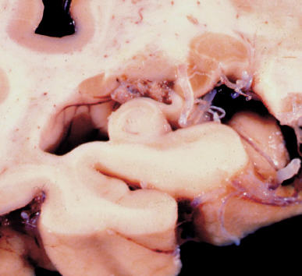
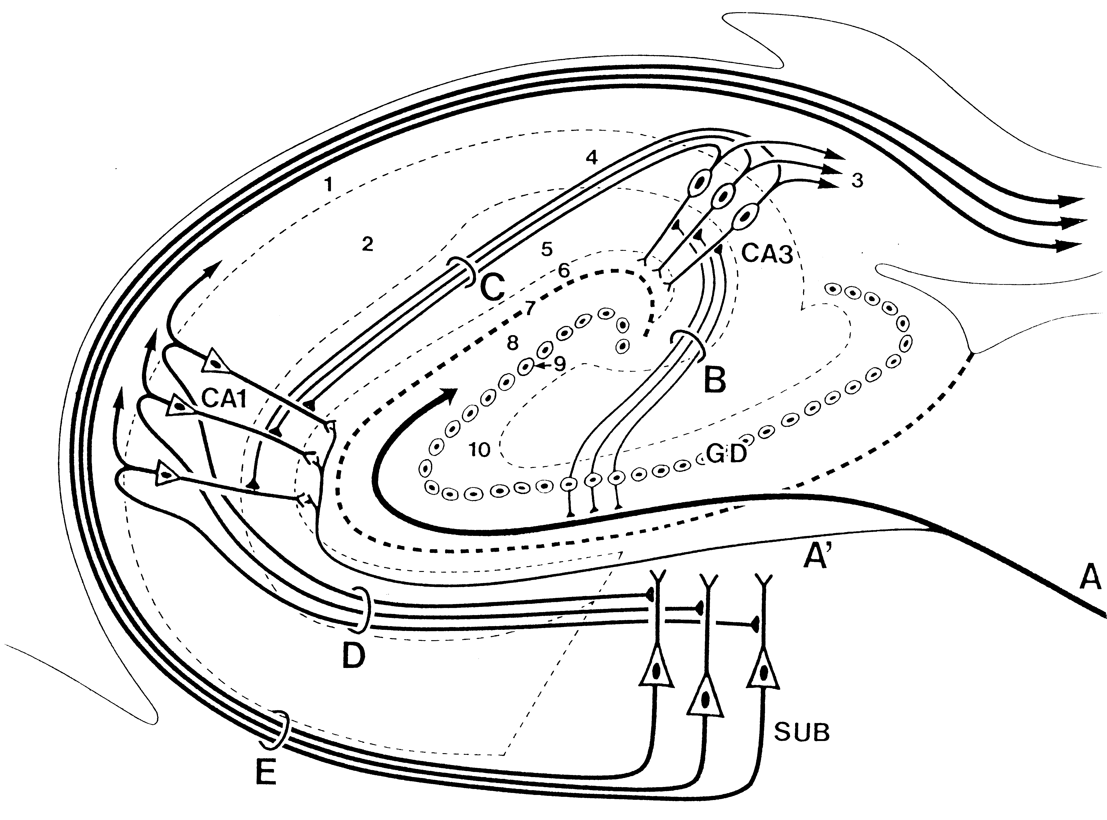
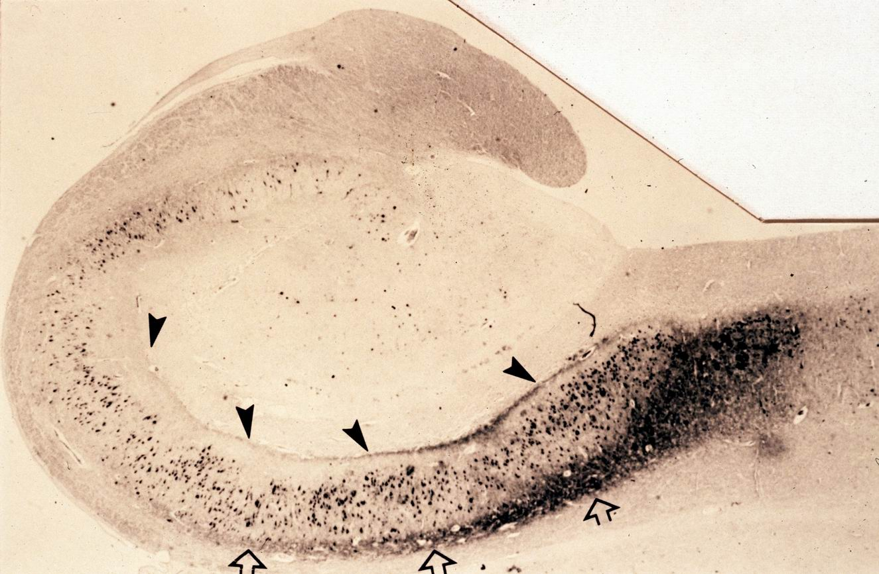
Tau phosphorylation in AD – early changes
Open arrows=subicular axons
Arrowheads=perforant pathway collaterals
AD
AT8 ICC

Slide 53
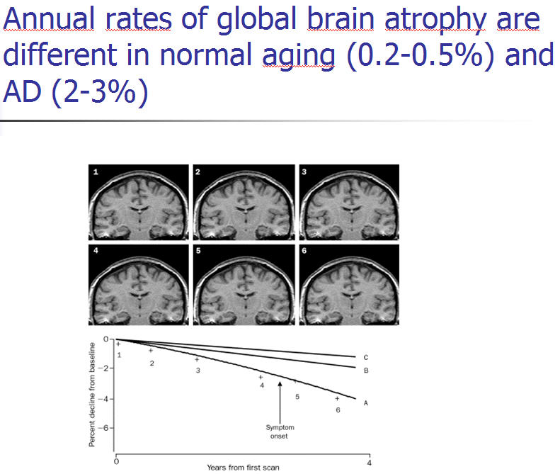
Fox et al. Lancet ‘04
Fox et al., Lancet ‘04

Slide 56
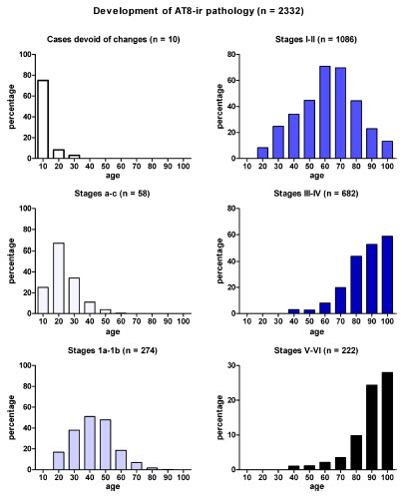
That abnormal tau protein occurred in pretangle stages or early NFT stages without the presence of insoluble A-amyloid plaques (1,291/2,332 cases) means that not only a rethinking of currently existing neuropathologic staging NFT categories for AD is necessary but also a rethinking of the hypothesis that A-amyloid drives AD pathogenesis and secondarily induces the formation of abnormal tau protein.
Sporadic AD may be the result of two separate assaults: first, a tauopathy, possibly beginning in childhood; and second, negative influences of beta-amyloid after a given threshold is crossed.

Slide 57
Nationally funded project
Identification and tracking of biological markers for early therapeutic intervention in sporadic Alzheimer’s disease
1 Jan 2012- 31 Dec 2014
22 collaborators
Croatian
Science
Foundation
Grant no. 09/16

