Slide 1
Proteomic analysis of the cerebrospinal fluid in Alzheimer’s disease Proteomska analiza cerebrospinalne tekućine u Alzheimerovoj bolesti
Prof. dr. sc. Goran Šimić, dr. med.
Redoviti profesor neuroznanosti i anatomije
Full Professor of Neuroscience and Anatomy
Zavod za neuroznanost, Hrvatski institut za istraživanje mozga
Department of Neuroscience, Croatian Institute for Brain Research
Medicinski fakultet Sveučilišta u Zagrebu
University of Zagreb Medical School
Prvi stručni sastanak Hrvatskog društva za Alzheimerovu bolest
i psihijatriju starije životne dobi HLZ
Hrvatski liječnički zbor, 11. ožujka 2013.
Hrvatska zaklada za znanost
Projekt br. 09/16 (2012-2014)
Croatian Science Foundation

Slide 3
Croatian Science Foundation project Projekt Hrvatske zaklade za znanost

Slide 4
Biološki biljezi AB u CST Biological markers of AD in CSF
Three main CSF biomarkers of AD, amyloid β₁₋₄₂ (Aβ₁₋₄₂), total tau (t-tau), and phosphorylated forms of tau proteins (p-tau). Reduction of Aβ₁₋₄₂ in CSF of AD patients is explained by Aβ₁₋₄₂ aggregation into senile plaques, while increase of t-tau reflects neuronal degeneration, and elevation of p-tau is a consequence of neurofibrillary degeneration and consequent tangles formation in the brain.
These CSF biomarkers are altered in early stages of AD, even before the occurrence of the first dementia symptoms. They permit to differentiate patients with prodromal AD (those with mild cognitive impairment, MCI) who often progress to AD, from healthy controls. CSF biomarkers are also used for differentiation of AD from other primary causes of dementia, such as vascular dementia, frontotemporal dementia, and dementia with Lewy bodies.
Detection of AD is also critically important in view of the growing number of potential new drugs that may influence the course of the disease in its early phases. However, cut-off levels (isključne vrijednosti) for these CSF biomarkers have not yet been established. Although numerous studies in which diagnostic accuracy of CSF biomarkers was analyzed have been published, an ideal biomarker (with specificity and sensitivity over 85%) could not yet be defined.

Slide 5
Biološki biljezi AB u CST Biological markers of AD in CSF
Variability in absolute concentrations of AD biomarkers is high among different centers, laboratories, and studies. Significant differences were noticed even within the same datasets.
Causes of variations could be either due to pre-analytical and analytical factors or differences in ELISA kits from various manufacturers. Pre-analytical procedures refer to selection of research participants, CSF sampling and treatment, sample storage (temperature, tube type), and freeze/thaw cycles. Analytical factors that influence results include differences in laboratory procedures among different centers. Variability among ELISA kits from different manufacturers is due to differences in production processes of reagents (e.g., usage of different materials for reagents, preparation of standards, antibody purification, and plate coating). Lot-to-lot variability among assays of the same kit is also an issue. Post-analytical procedures such as curve-fitting type, curve-fitting software, and number of samples analyzed (usually singlets or duplicates) can also affect outcome.

Slide 6
Usporedba ELISA kitova dvaju vodećih proizvođača Comparison of ELISA kits of two major manufacturers
As there are insufficient data on comparability of ELISA kits developed by different vendors, we compared the performance of Innogenetics (Gent, Belgium) and Invitrogen (Camarillo, CA, USA) ELISA kits for t-tau and Aβ₁₋₄₂.
Analyses were performed in the Laboratory for Developmental Neuropathology (LDN), Croatian Institute for Brain Research, University of Zagreb Medical School, Zagreb, Croatia, and in the Laboratory for Neurobiochemistry (LNB), Department of Laboratory Diagnostics, University Hospital Centre, Zagreb, Croatia.

Slide 7
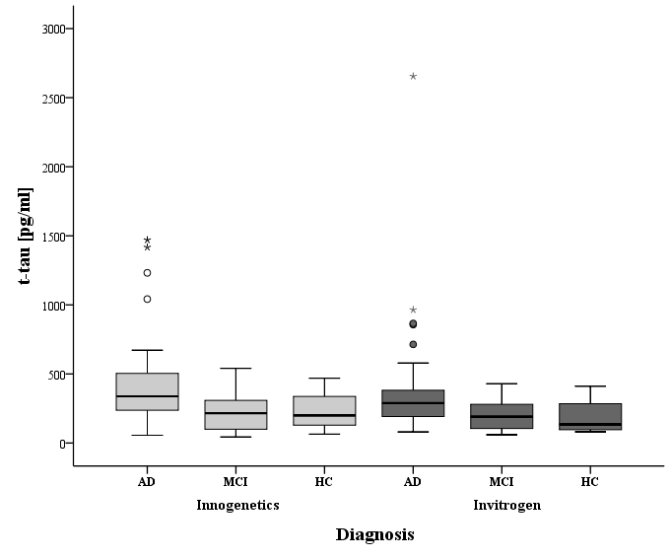
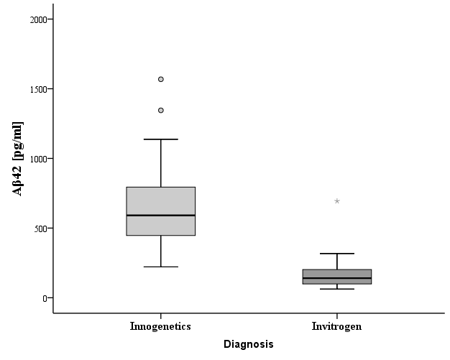
Usporedba ELISA kitova dvaju vodećih proizvođača Comparison of ELISA kits of two major manufacturers
CSF t-tau levels in AD, MCI and HC subjects measured by Innogenetics and Invitrogen ELISA kit
Boxes represent the median, the 25th and the 75th percentiles, bars indicate the range of data distribution. Circles represent outliers (values more than 1.5 box-length from the 75th/25th percentile). The asterisks represent extreme values (value more than three box-length from the 75th/25th percentile).
CSF Aβ₁₋₄₂ levels in AD patients measured by Innogenetics and Invitrogen ELISA kit
Boxes represent the median, the 25th and the 75th percentiles, bars indicate the range of data distribution. Circles represent outliers, the asterisk represents an extreme datapoint.

Slide 8
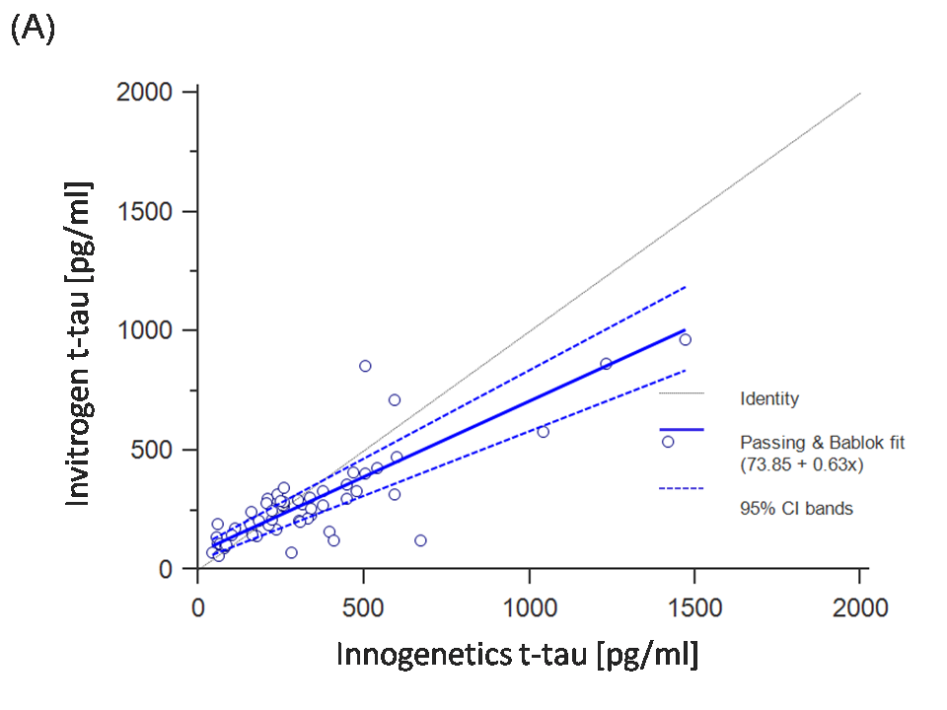
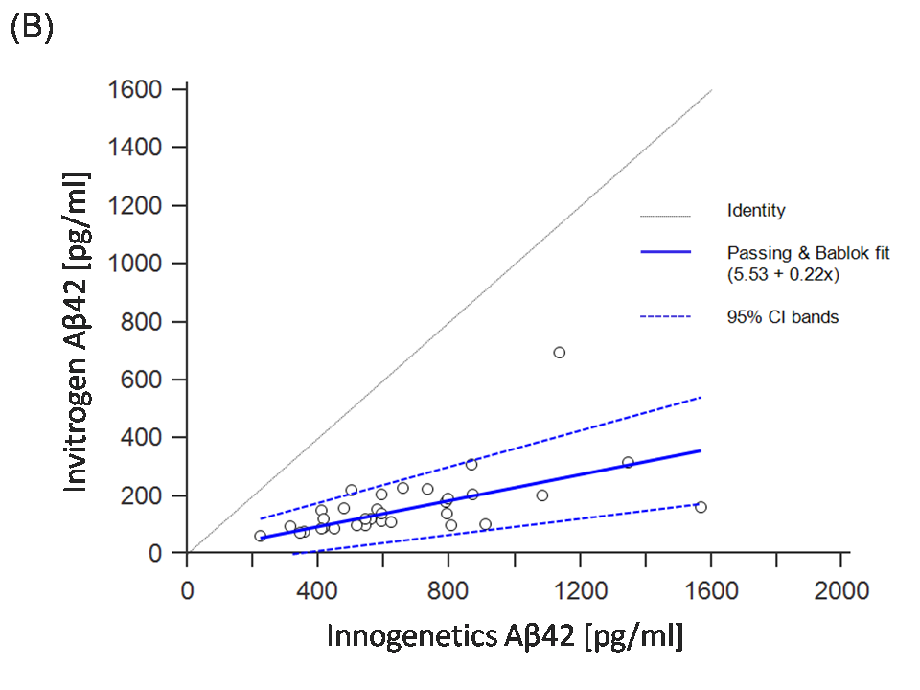
Usporedba ELISA kitova dvaju vodećih proizvođača Comparison of ELISA kits of two major manufacturers
Results of the Passing-Bablok analysis between Innogenetics and Invitrogen ELISA for (A) t-tau and (B) Aβ₁₋₄₂. Note that levels of both t-tau and Aβ₁₋₄₂ measured by the Innogenetics kit were significantly higher than those obtained with the Invitrogen kit. Passing-Bablok analysis showed significant differences between Invitrogen and Innogenetics ELISA methods, making it impossible to use them interchangeably.

Slide 9
Usporedba ELISA kitova dvaju vodećih proizvođača Comparison of ELISA kits of two major manufacturers
ZAKLJUČAK: Kod multicentričnih istraživanja ne smiju se koristiti
komercijalni ELISA kitovi različitih proizvođača!
CONCLUSION: Multicenter studies should not use commercial
ELISA kits from different manufacturers!

Slide 10
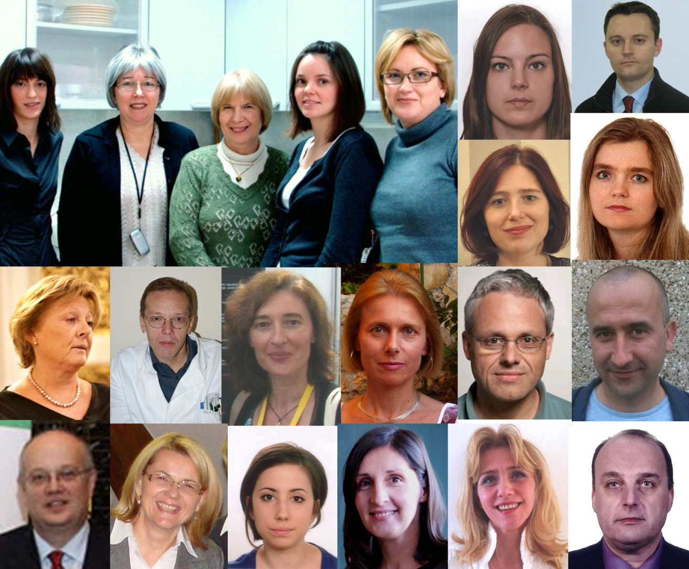
Collaborators / Suradnici na projektu
Hrvatska zaklada za znanost
Projekt br. 09/16 (2012-2014)
Matea Nikolac, Nela Pivac, Dorotea Mück Šeler, Gordana Nedić, Maja Mustapić, Mirjana Babić, Fran Borovečki, Dubravka Švob Štrac, Maja Jazvinšćak Jembrek, Sanja Hajnšek, Ratimir Petrović,
Svjetlana Kalanj Bognar, Željka Vukelić, Patrick R. Hof,
Milan Radoš, Ninoslav Mimica, Paola Presečki, Danira Bažadona, Nataša Jovanov Milošević, Gabrijela Stanić, Neven Henigsberg
Croatian Science Foundation

